Slide 1
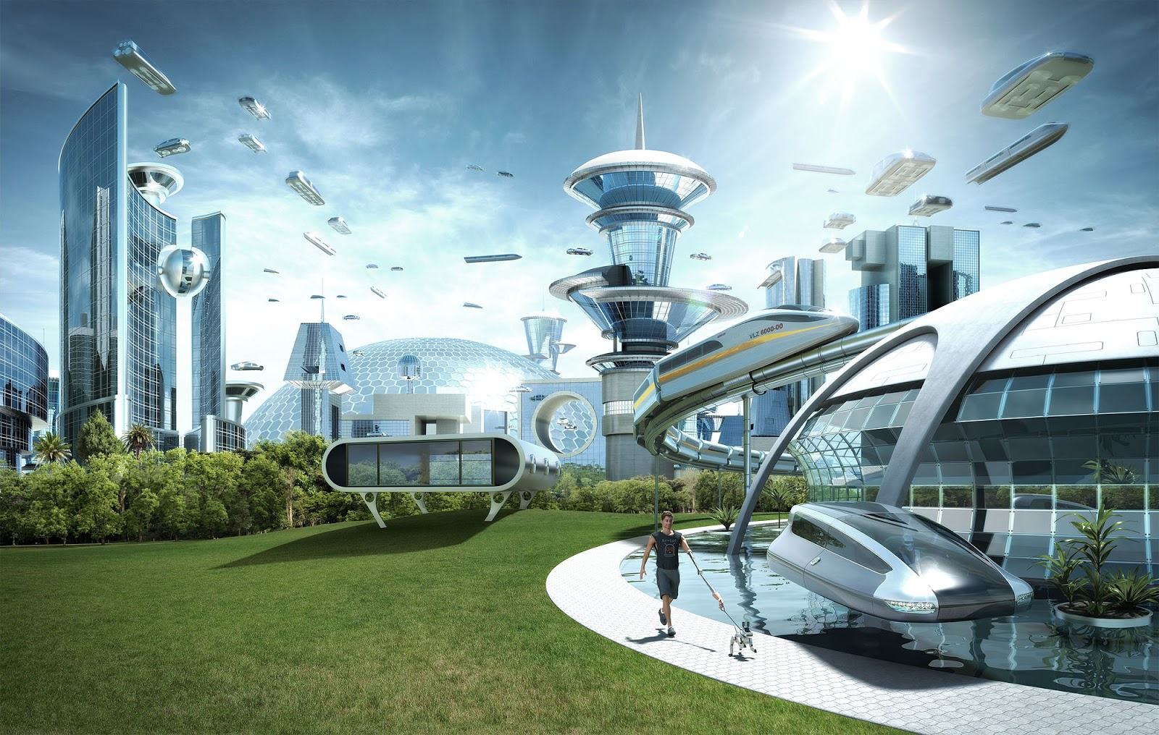
Robotic Process Automation (RPA) and PDF
Robo-PDF Apocalypse or Automated PDF Utopia?
Version - 8 Sept 2020
Neil Pitman Managing Director, Aquaforest Limited
Monday, October 27th 2020 5PM CET

Slide 2
Session Overview
Robotic Process Automation (RPA)
Uses software robots to mimic human actions and automate everyday tasks.
This session will cover
The place that PDF plays in the RPA
How RPA fits in the wider spectrum of automation.
Typical use cases
PDF-centric issues that need to be considered for successful implementations.

Slide 3
Agenda
RPA and the Automation Spectrum
Demonstration : PDF and RPA
PDF and RPA : The Challenge

Slide 4
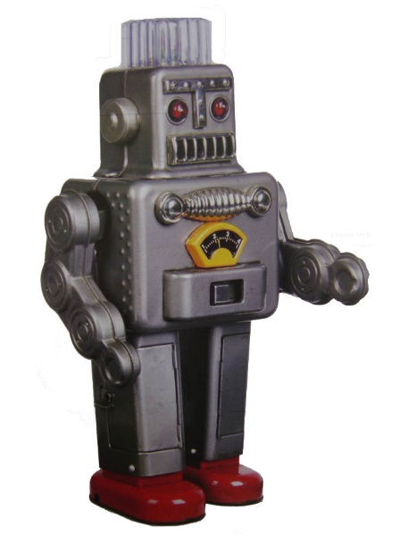
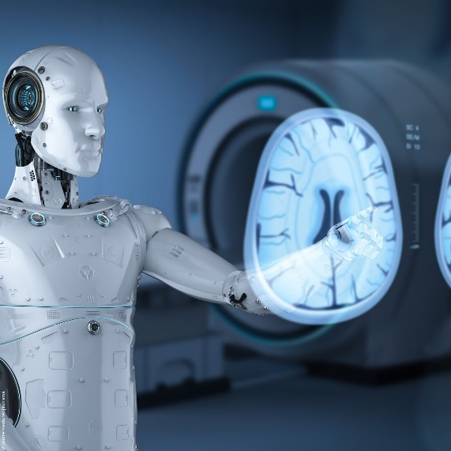
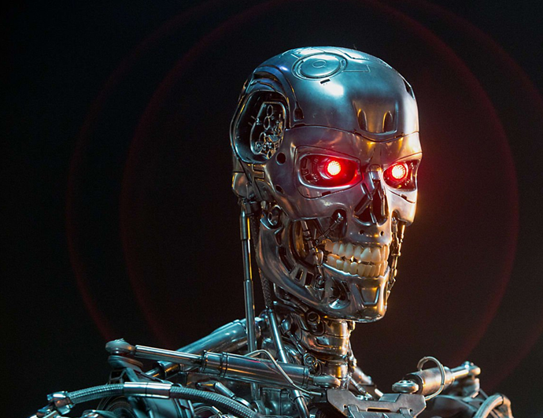
RPA and the Automation Spectrum

Slide 5
Robotic Process Automation
Mimics Human Actions
Used for rules based processes
Enables
Faster handing time
Higher volumes
Reduced errors & costs
Without impacting existing systems

Slide 6
Typical Processes
Business Process
Consistent and routine
High volume
Prone to human error
Limited in requiring a person to make a decision
Manual data entry or “swivel chair” work
Technology
Legacy Systems
No APIs

Slide 7
Common Use Cases
Payroll
Employee status changes
New hire recruitment and onboarding
Accounts receivable and payable
Invoice processing
Inventory management
Report creation
Updating CRM data
Software installations
Data migration
Vendor onboarding

Slide 8
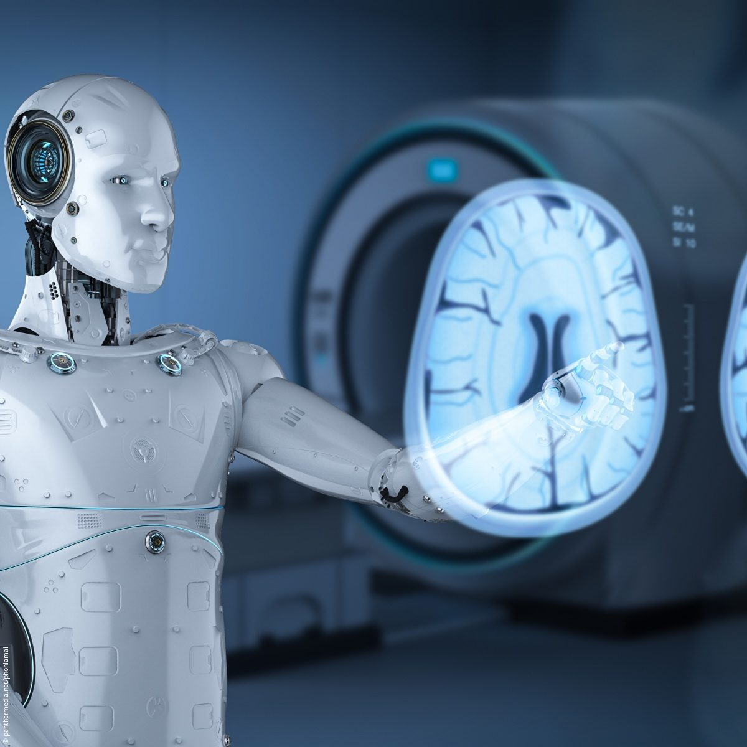
Intelligent Automation
Mimics Human Judgement
Used for judgement based processes
Machine learning capability
Interprets human behaviour

Slide 9
Cognitive Intelligence
Imitate Human Processes
Natural Language
Image Recognition
Augments Human Intelligence

Slide 10
AI
Mimics Human Intelligence
Acquires human-like thought processing and thinking capabilities

Slide 11
RPA Demonstration
Demonstration using Microsoft Power Automate
Many other RPA platforms are available

Slide 12
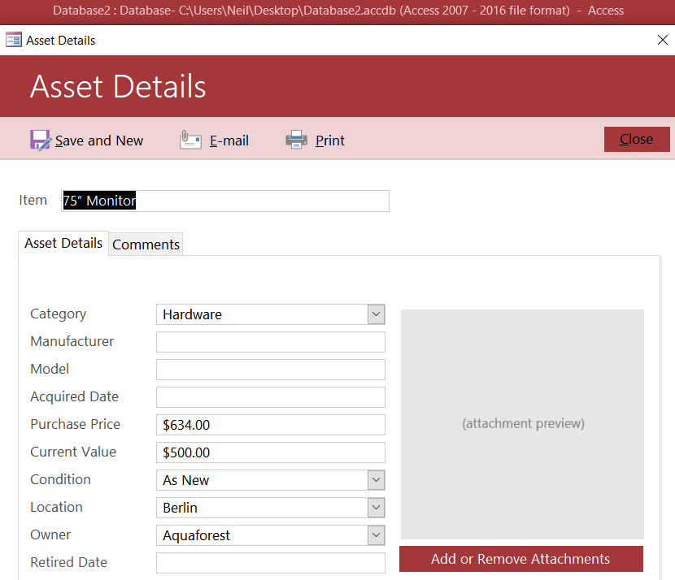
Asset Registration Use Case
Asset Registration

Slide 13
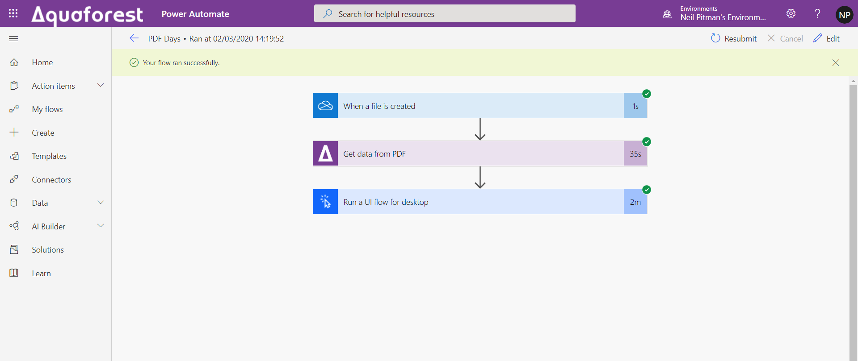
RPA Workflow

Slide 14
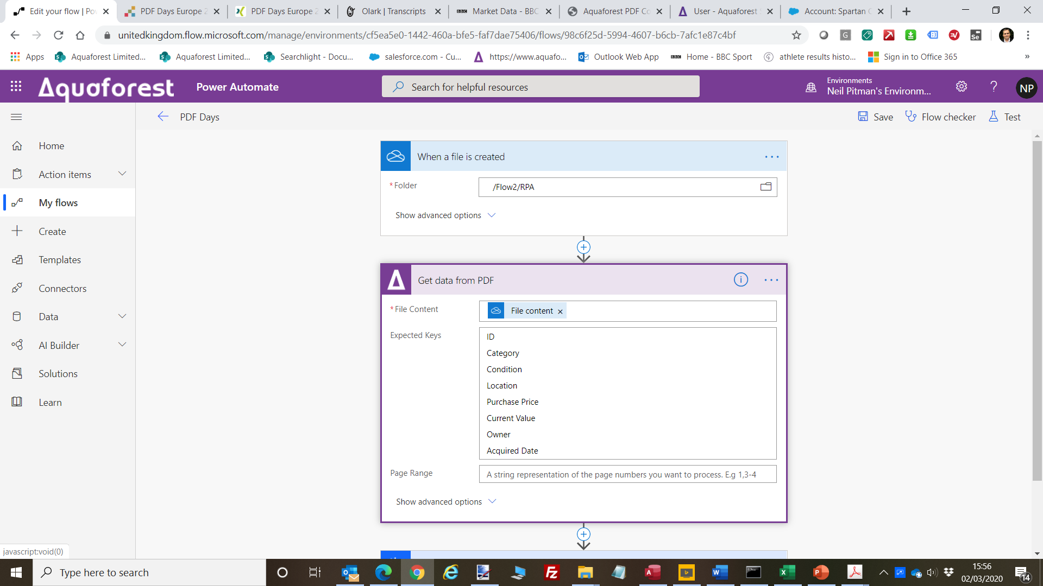
Get The PDF Data

Slide 15
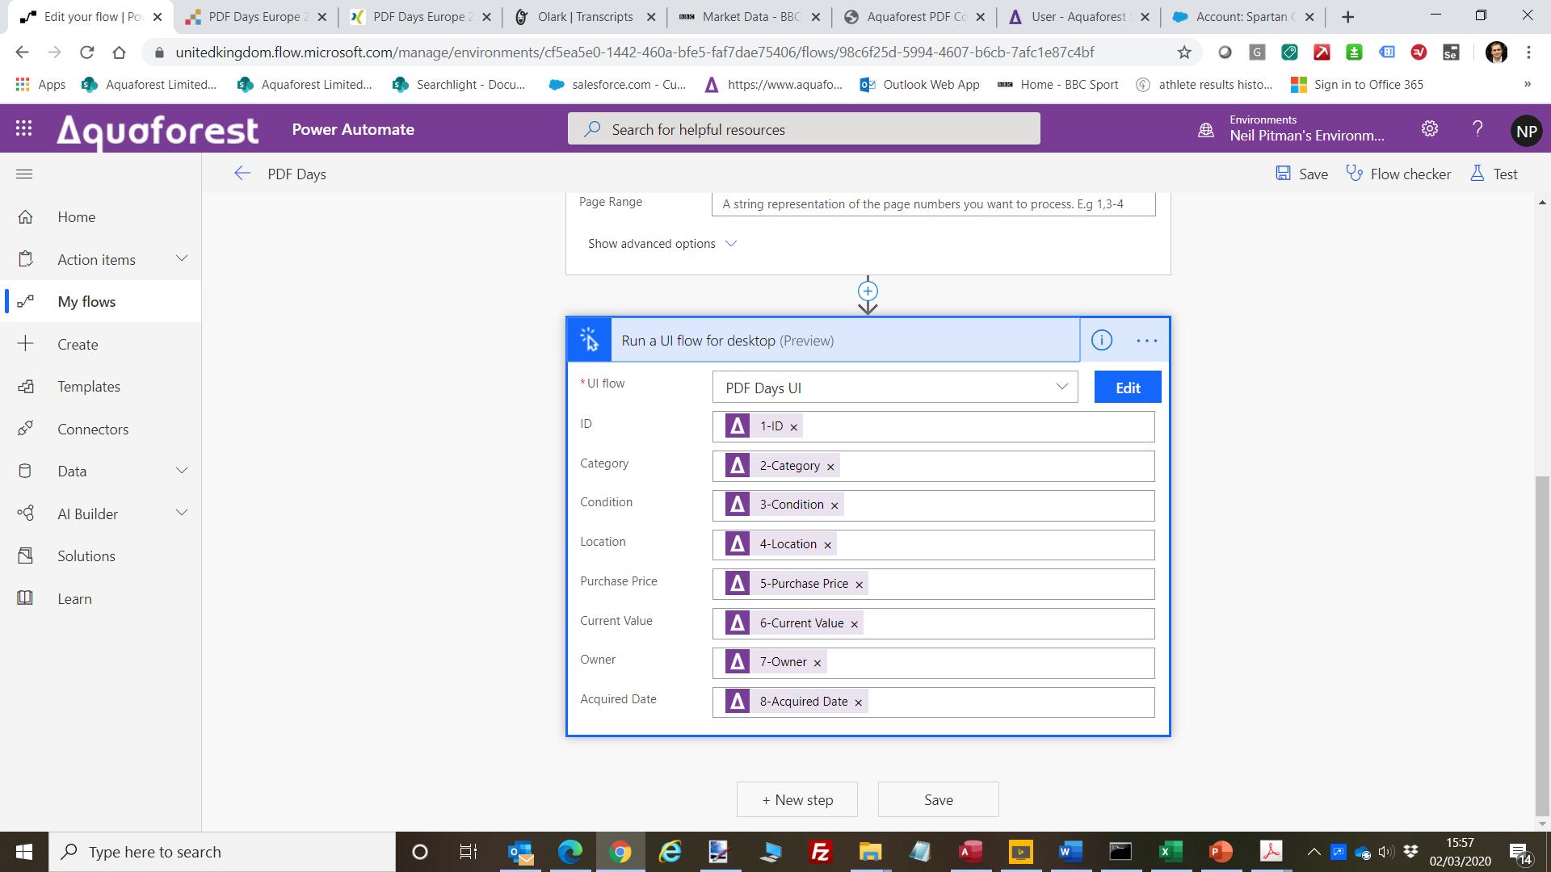
Send The Data to the UI Flow

Slide 16
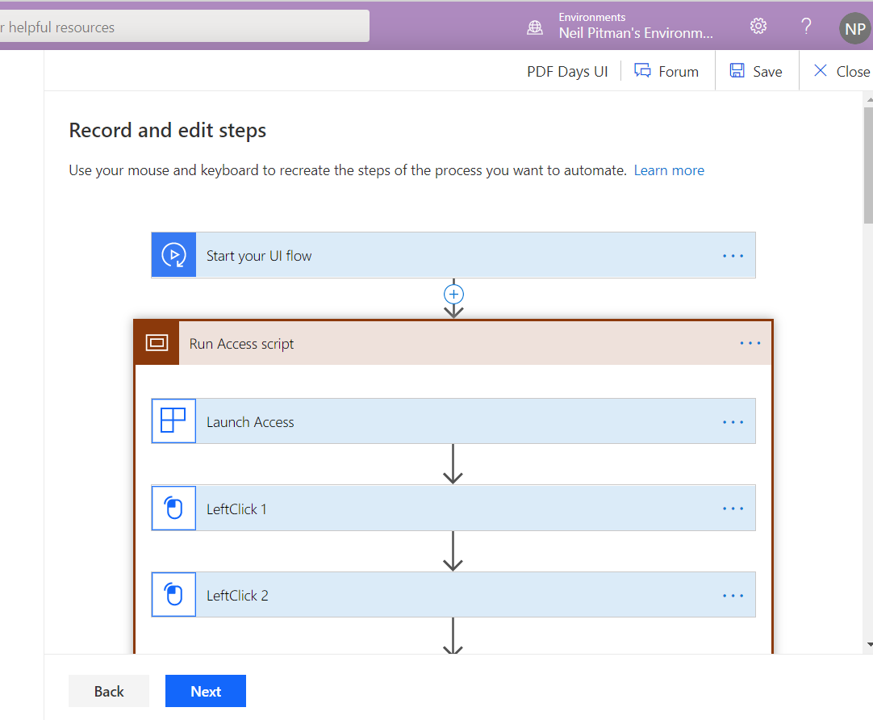
UI Flow Automates User Actions

Slide 17
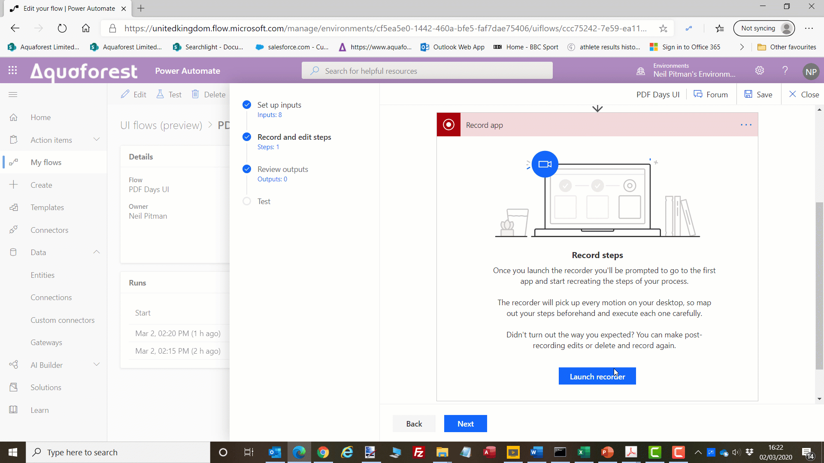
Demo Video#1 – Recording UI Flow

Slide 18
Demo Video#2 – RPA Running
<Video Here>

Slide 19
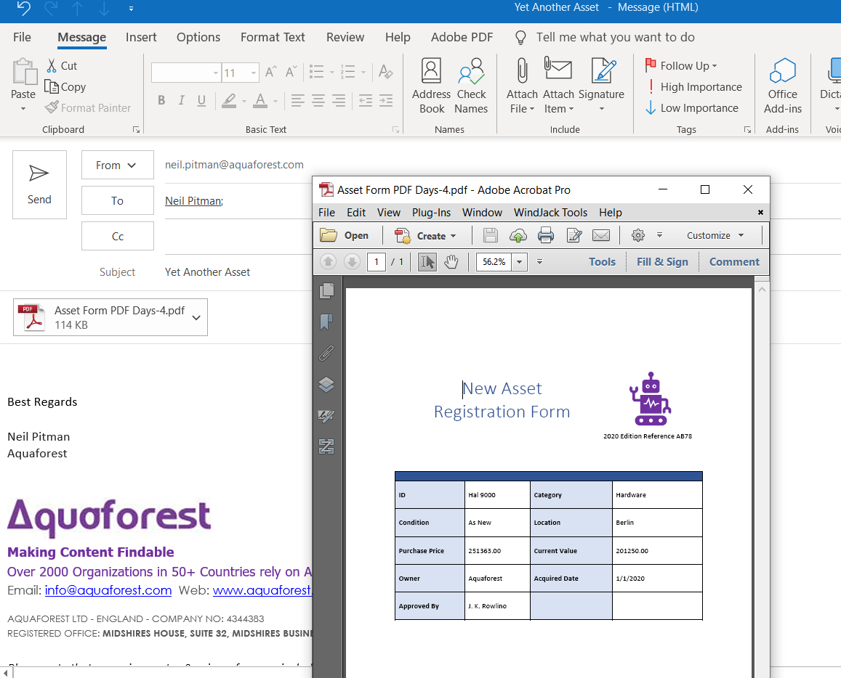
“Unassisted” Use Case

Slide 20
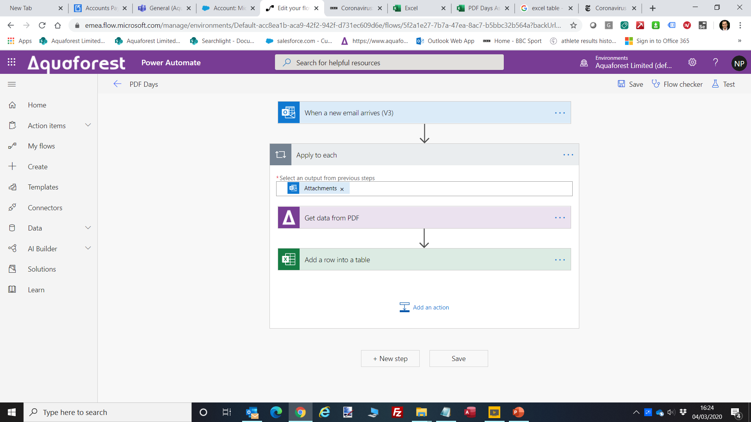

Slide 21
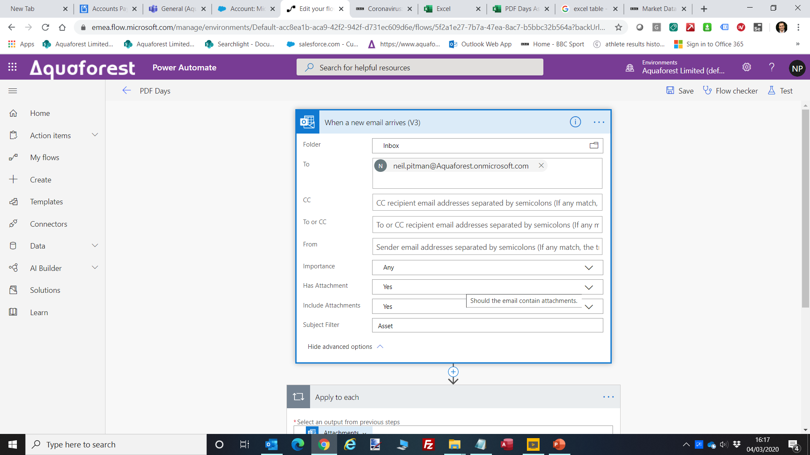

Slide 22
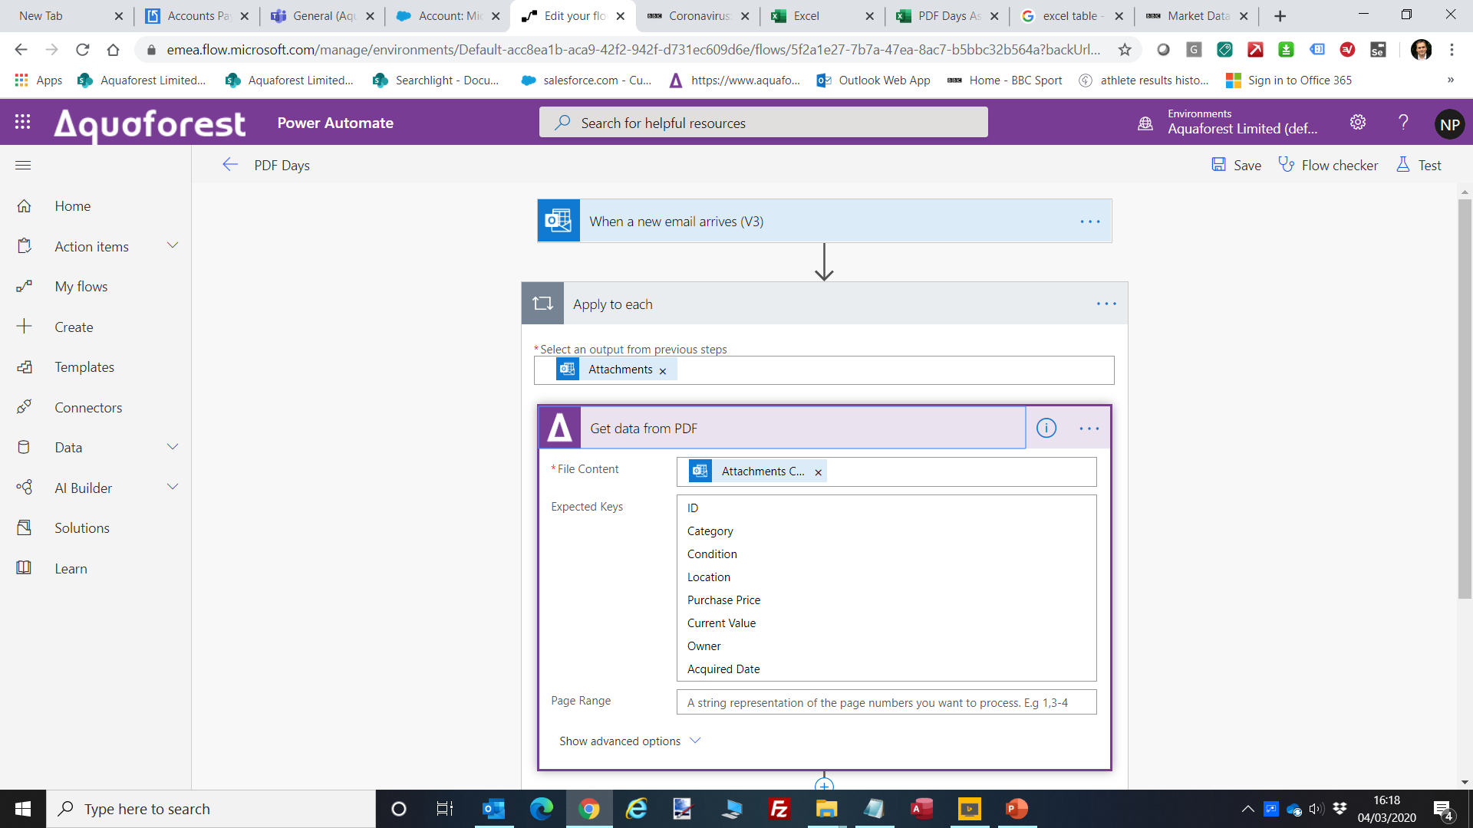

Slide 23
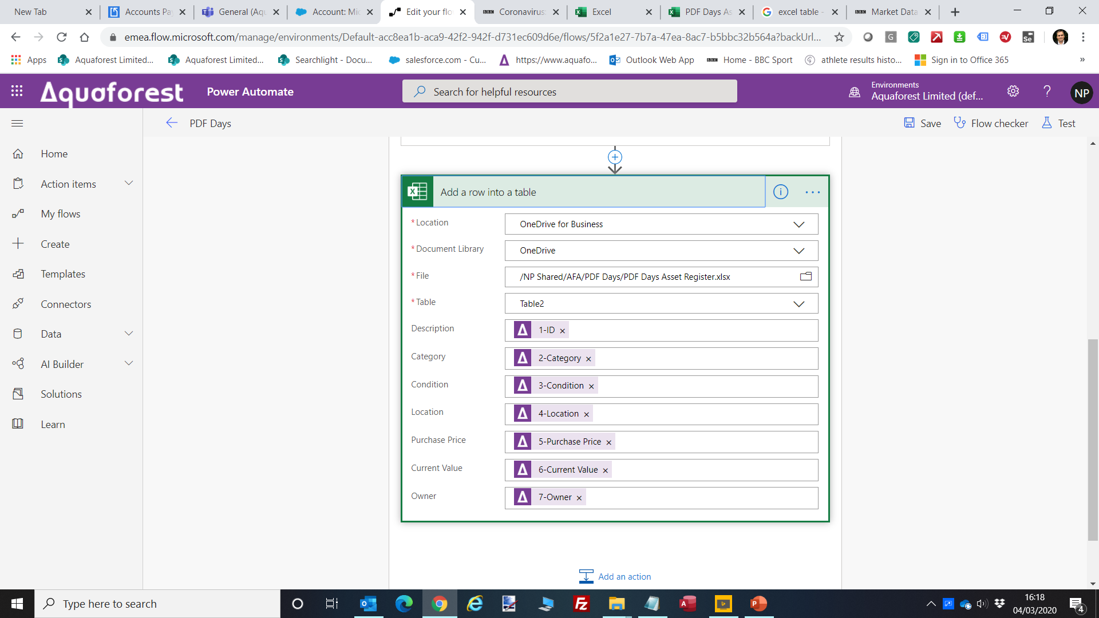

Slide 24
Simple Unassisted Case

Slide 25
PDF Data for RPA : The Challenge
As part of the RPA pipeline
Extract, Process and Recognize PDF
Structured and Semi-Structured data

Slide 26
PDF Data for RPA : Approaches
Rely on Text Extraction Alone
XMP
Embedded
XML
JSON
Tagged PDF
Custom Metadata

Slide 27
PDF Text Extraction Issues
Extractable Data
Security
Full Text
Character Encoding
Text Sequencing

Slide 28
XMP

Slide 29
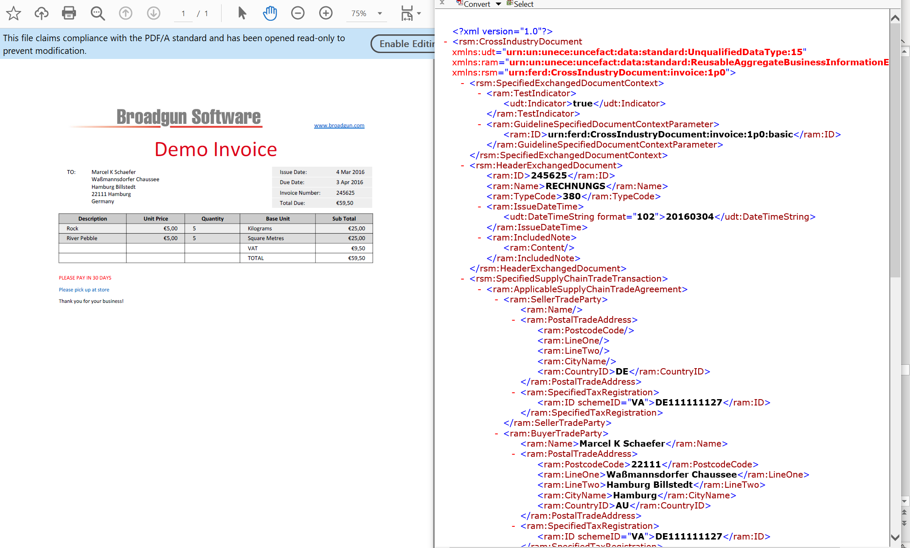
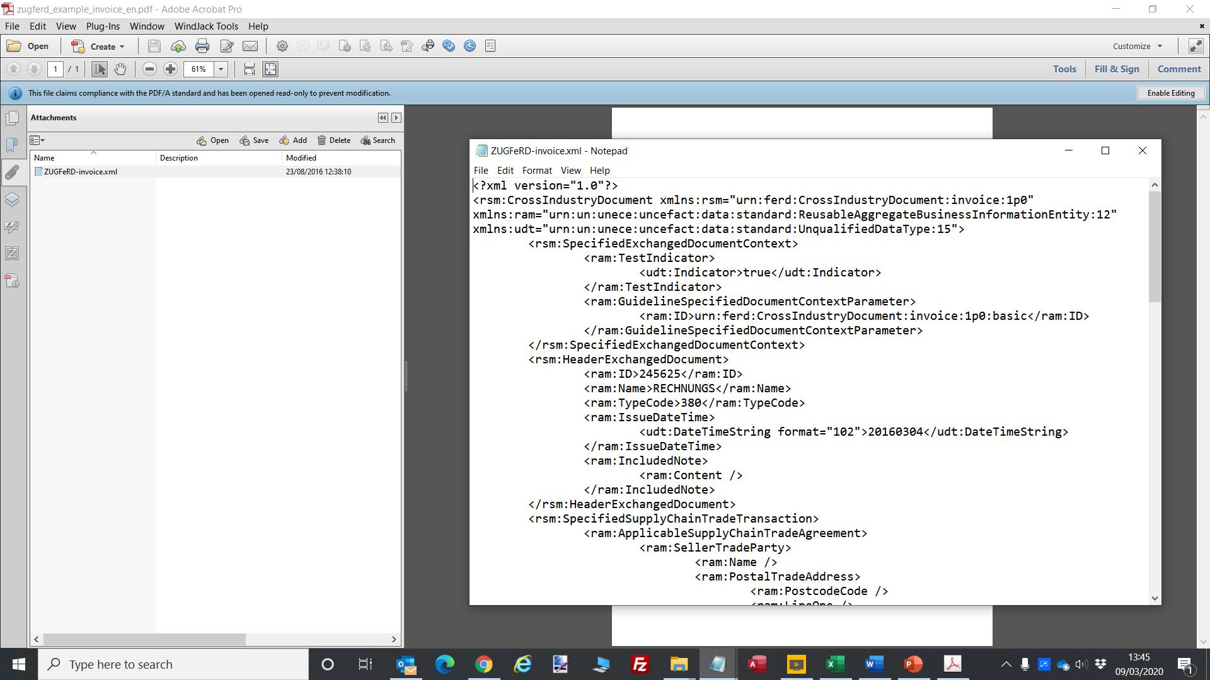
Embedded XML or JSON
ZUGFerd
PDF/A-3

Slide 30
Future for PDF in RPA
PDF is a natural part of the RPA pipeline
Aim for reliable “Machine Readable” PDF
Use extraction technologies today if needed
See also
https://www.pdfa.org/pdfcontainer-a-proposal/

Slide 31
Session Summary
Robotic Process Automation (RPA)
Uses software robots to mimic human actions and automate everyday tasks.
This session covered
The place that PDF plays in RPA
How RPA fits in the wider spectrum of automation.
Typical use cases and demos
PDF-centric issues that need to be considered for successful implementations.

Slide 32
Aquaforest

Slide 33
Aquaforest
2,000 customers 50 countries

Slide 34
Flagship Products

Slide 35
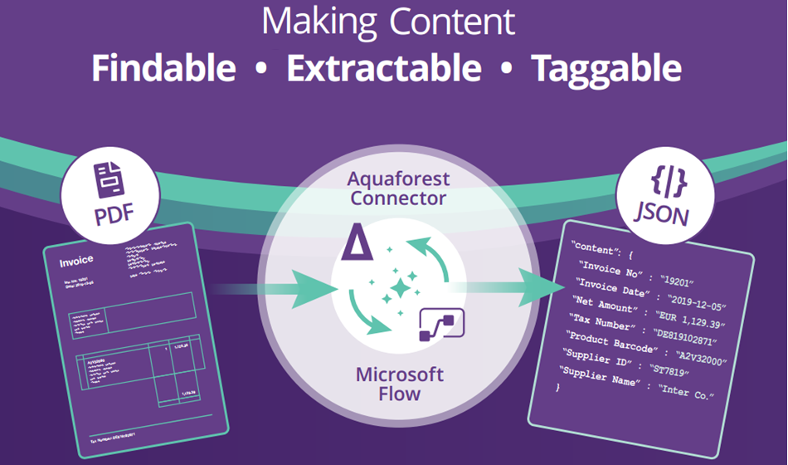
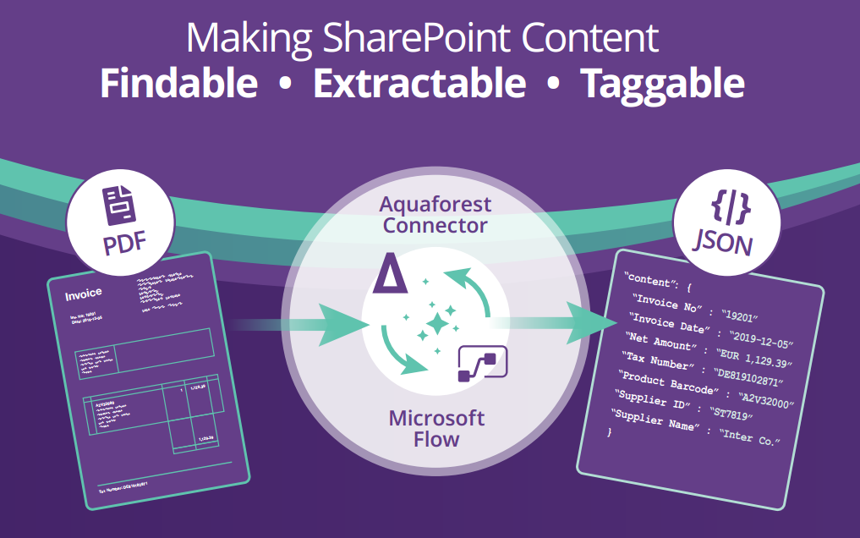
Aquaforest PDF Connector

Slide 36
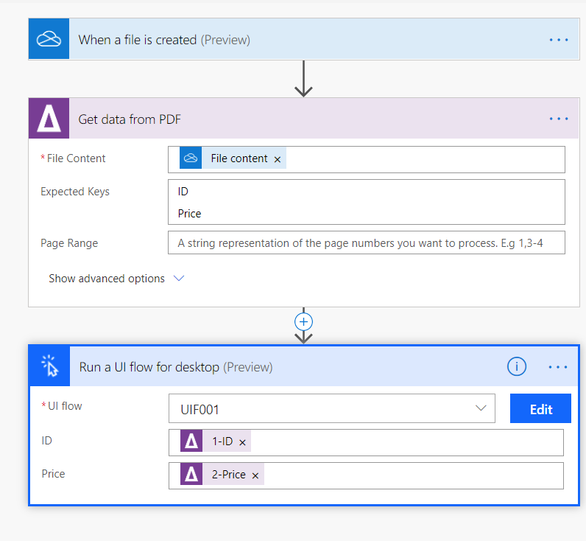
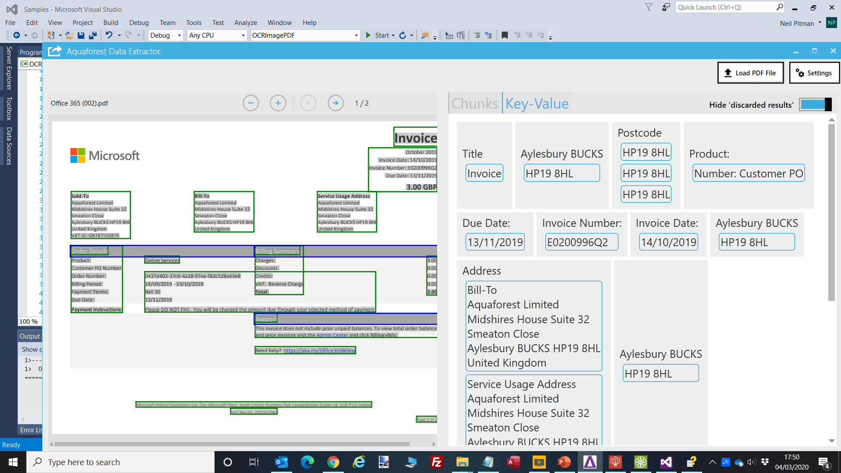
Aquaforest PDF Connector
Show PDF***

Slide 37
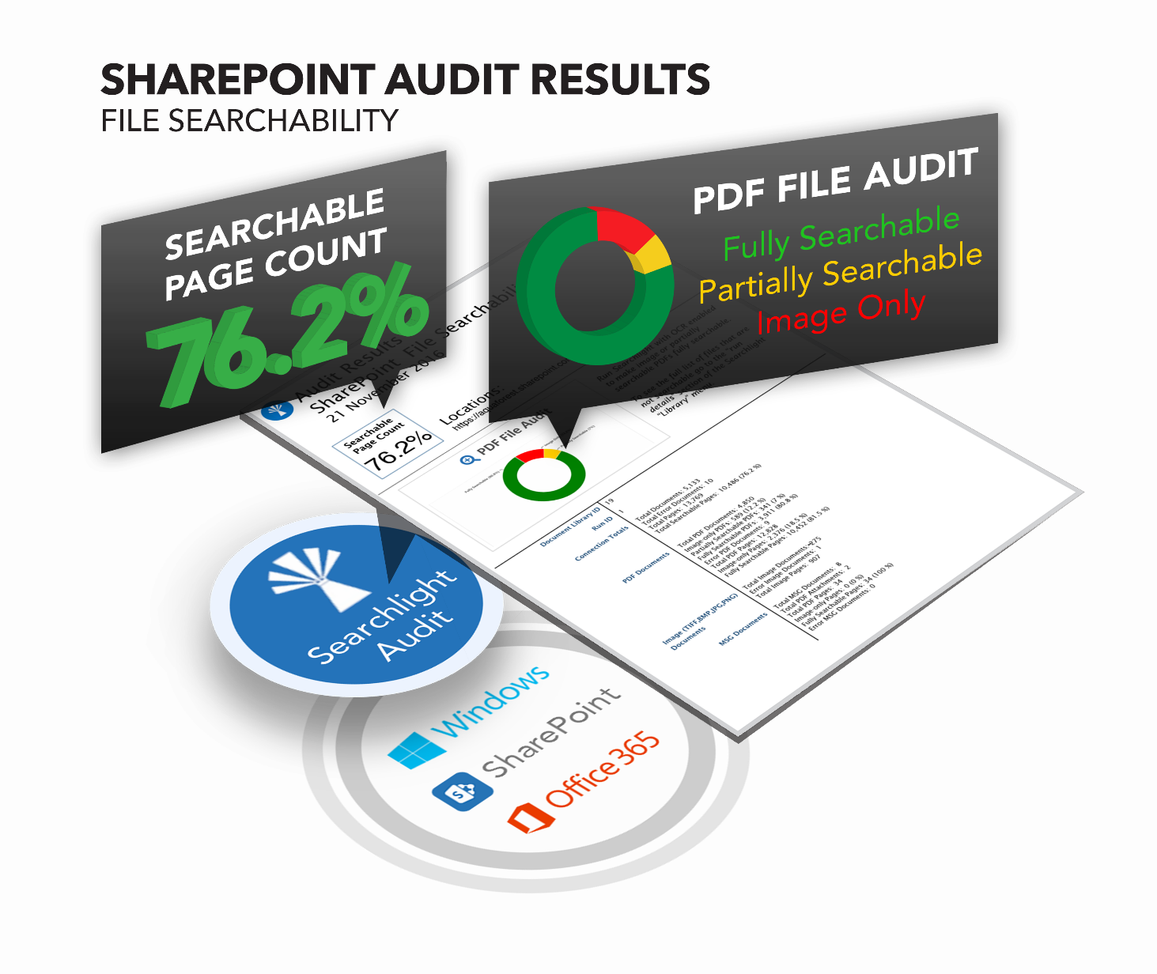
Aquaforest Searchlight
Notes:
Capture time can be too much overhead…. Can be forgotten
Demand for in-place

Slide 38
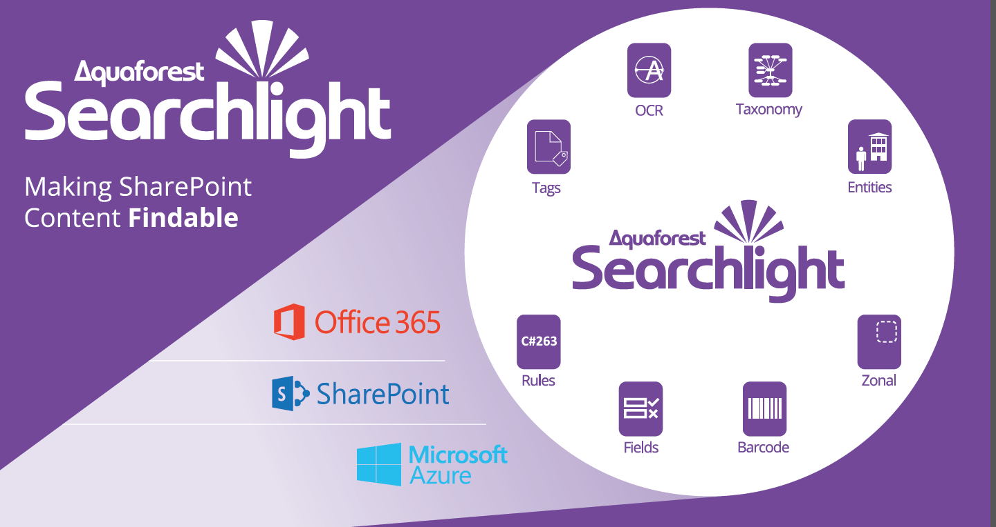
Aquaforest Searchlight

Slide 39
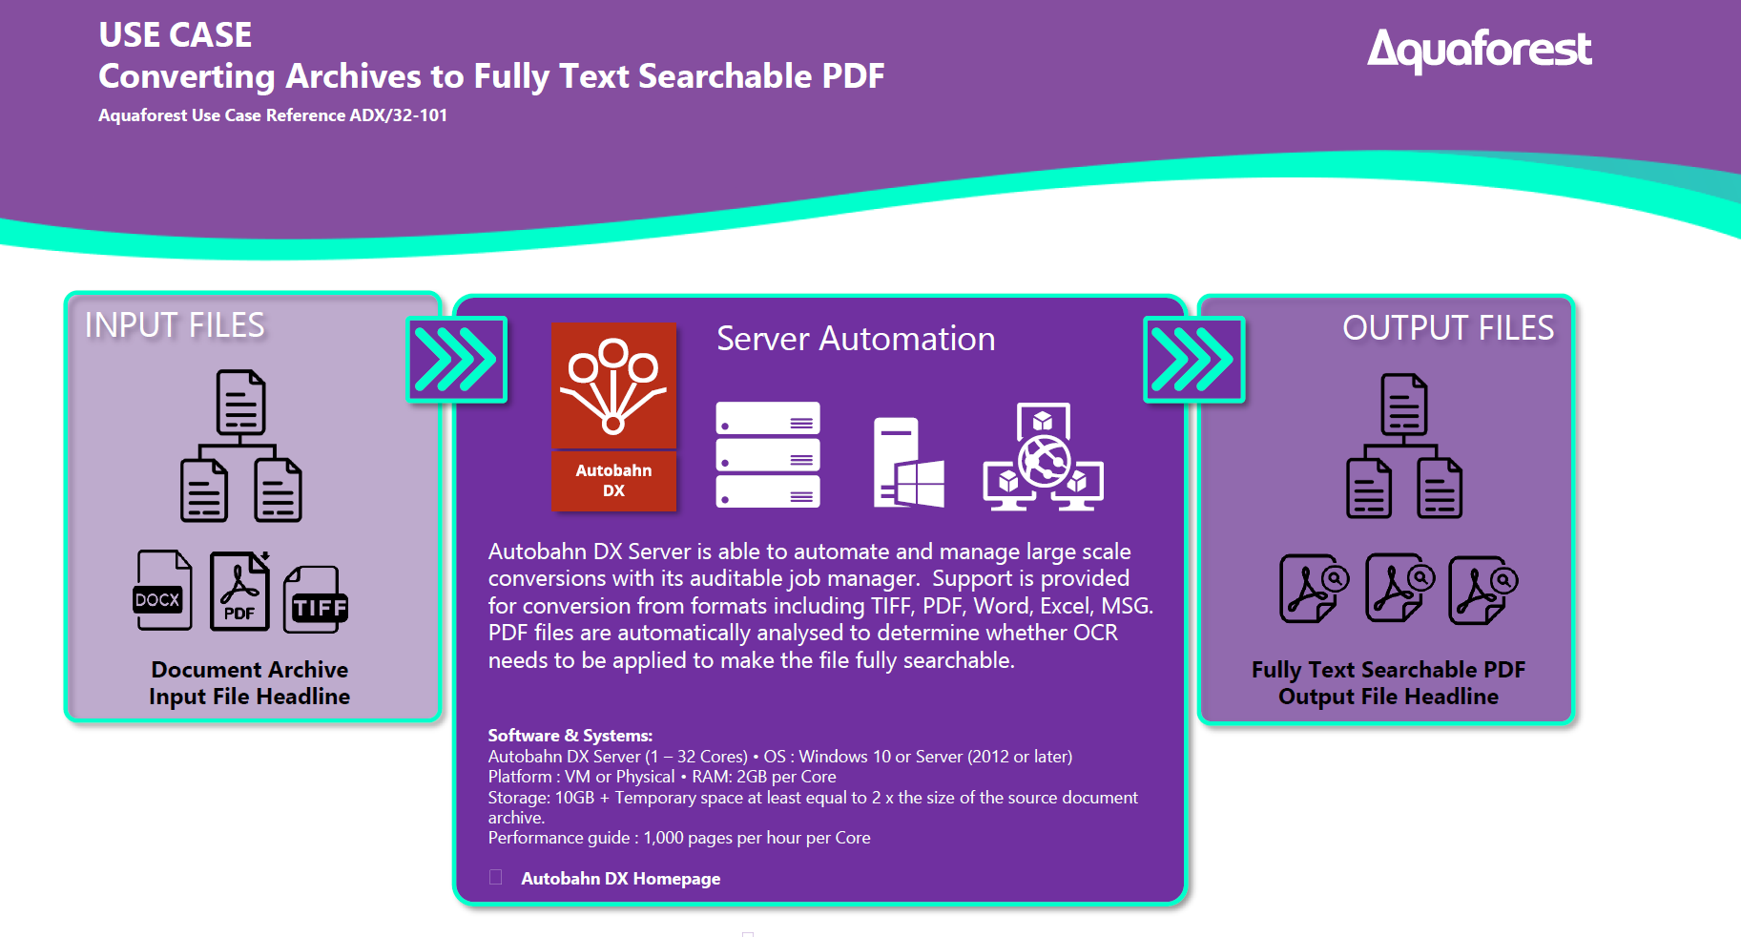
Autobahn DX

Slide 40
Aquaforest

