Slide 1
Improving Efficiency
with your remote workforce
Tim Jefferies – Director of Sales – Enterprise Automation – Foxit Software

Slide 2

Partner
Things Have Changed…
Documents Replace Paper
  New Documents
    2019: 43% Paper
    2025: 25% Paper
Broad Cloud Adoption
  Enterprises use
    83% of workloads by 2020
    50% spend >$1.2m on cloud/year
Everyone is Remote / Mobile
  Remote Work has been growing for years
    159% growth in past 12 years
    81% need mobile access to documents
Business Pain
  Increasing Compliance Risks
  Inefficient Business Processes
  Increasing Exception Costs
Source: InfoSource - Capture 2019 Conference
Business Pain
  High Storage Costs
  Unpredictable Access Fees
  Painfully Slow Migrations
Source: Cloud Adoption Statistics for 2020
Business Pain
  Internet Bandwidth Varies
  Slow File Open Times
  Slow/Unable to Upload
Source: FlexJobs & Global Workplace Analytics Report
Source: Why ECM Is Essential for Your Business

Slide 3
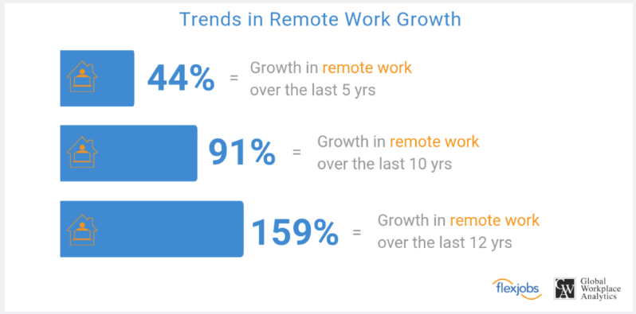
Remote Work has been growing for years
  Growth has been seen in a variety of industries
    Public, private, and non-profits
  Highly sought after employee benefit
  Many organizations have systems in place to implement remote work
* https://www.flexjobs.com/blog/post/flexjobs-gwa-report-remote-growth
Notes:
“Remote work has grown steadily since 2005, as companies of all types—private, public, nonprofit, or startup—continue to recognize the bottom-line benefits of integrating remote work into their business strategies,” said Sara Sutton, founder and CEO of FlexJobs. “With improvements to technology, and increasing demands from employees in a tight labor market, we fully expect to see the momentum around this important workplace continue to grow,” Sutton concluded

Slide 4

Faster Access to Files for GE Water and Power
Poor Employee Efficiency
  Remote site bandwidth slow
  Significant time wasted for large, critical documents to download
Objective
    Standardize on web optimized searchable PDF file format
    Compress documents to improve access performance
Result
    ~45% file size reduction
    File open times reduced from 3–5 minutes to <30 seconds

Slide 5

Keeping Documents in the Original File Format
High IT Costs/Overhead
  Maintain multiple document viewers
Risk/Liability
  Can I find everything?
  Will files open in 10 years?
Poor Efficiency
  Slow document access for remote & mobile users
Objective
Objective
Objective
  Standardize on PDF to eliminate viewers
  Make content searchable via searchable PDF/A
  Compress documents to speed up document access
Result
Result
Result
  Costs/Overhead eliminated
  All content is searchable and long-term archive ready
  55% file size reduction speeds up access by 55%

Slide 6

Compress Over 1 Billion Images per Year
Objective
High Storage Costs
  Storage and back up requirements not met
    Mortgage documents need to be retained for as much as 37 years
    Optimize process and compress images to limit additional storage costs, and improve overall efficiency
Result
    ROI achieved within one year
    Direct integration with existing workflow
    1.25 billion images compressed within a year without downtime

Slide 7
How Small is Small?

Slide 8
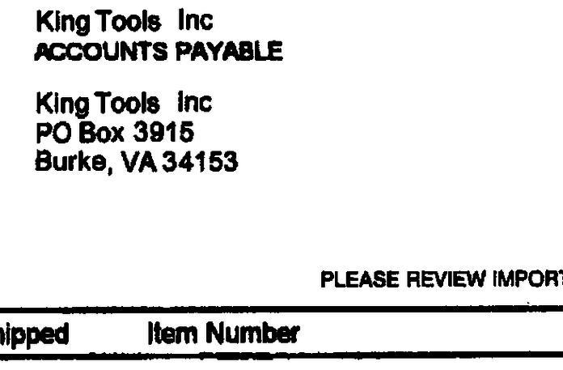
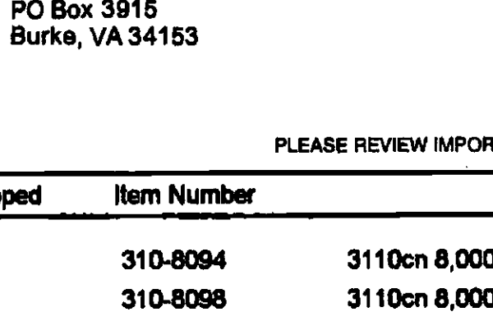
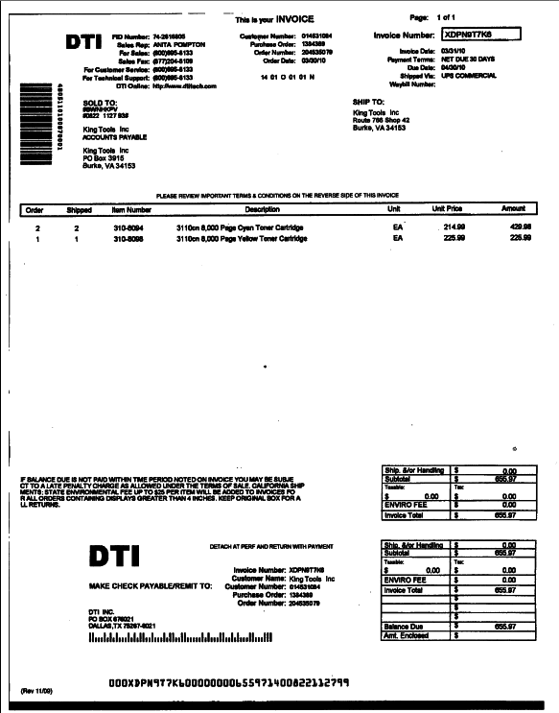
Compression Example – Bitonal Invoice
Original TIFF image – 141 KB
Compressed PDF – 34 KB
Searchable PDF – 76% smaller

Slide 9
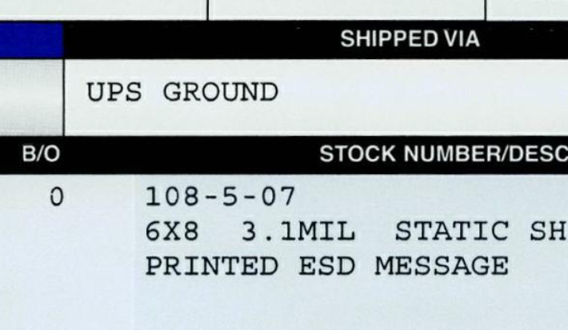
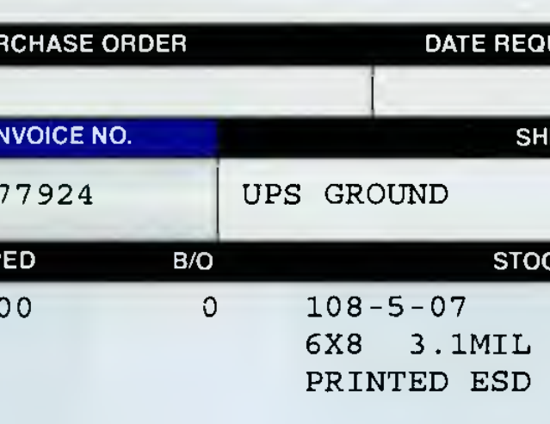
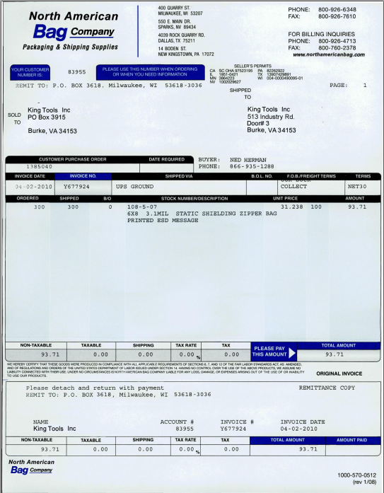
Compression Example – Color Invoice
Original TIFF image – 526 KB
Compressed PDF – 39 KB
Searchable PDF – 93% smaller

Slide 10
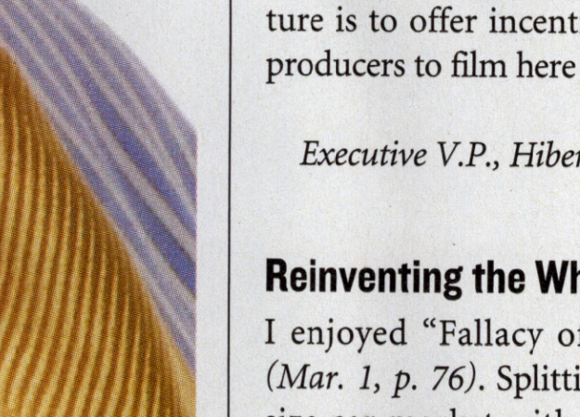
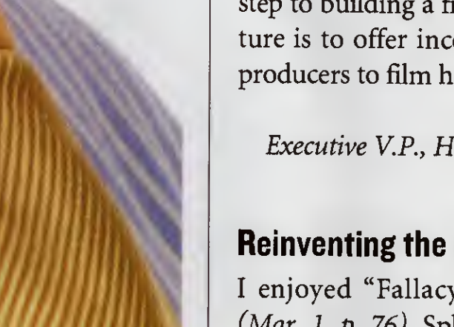
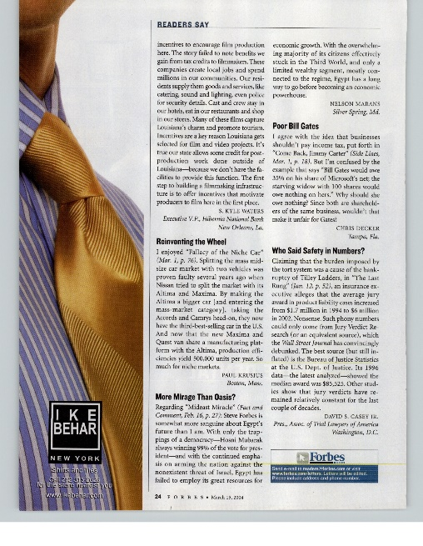
Compression Example – Color Invoice
Original JPEG image – 7,029 KB
Compressed PDF – 60 KB
Searchable PDF – 99% smaller

Slide 11

Remote Worker Productivity Problem
Poor Connectivity is Often Underestimated
  thousands of hours lost waiting for documents to open
Businesses are Impacted in Multiple Ways
  Poor customer satisfaction
  Missed business SLAs
  Customer & revenue loss
  Increased labor costs
50% Faster Document Access
  Reduce file download times via advanced document compression
  Speed up file open times via linearization
  Speed up content access by making files searchable

Slide 12

Business Justification
Slow remote file open time – Productivity Loss Estimator
Notes:
Claims processing, mortgage processing, new account opening, invoice processing, …
How many claims, mortgages or invoices could you have processed in a 1000 hours?
How many customers could have been served more quickly?
How much better could your margin have been?
How much better could be the user experience of your mobile and web apps be?

Slide 13
Business Justification
Document Storage & Egress Cost Estimator

Slide 14

But I pay for broadband at home…
More people are home
  Companies like Netflix are downgrading video quality*
  eLearning is taking place for the first time ever
Solve the problem at it’s core
  Leverage advanced document compression
  Speed up file open times with web optimization
https://deadline.com/2020/03/eu-netflix-ceo-switch-to-standard-definition-coronavirus-1202887374/
Notes:
A 2018 Ookla report found that during Q2-Q3, the average download speed over fixed broadband in the U.S. was 95.25 Mbps during Q2-Q3. To provide some context, the general download speed requirements for downloading large files is 200+ Mbps. Minimum.
As defined by the FCC, a “broadband” internet connection provides at least 25 Mbps for download speed. While this may be a decent benchmark for the average family, it may not be enough for your work usage. Considering the fact that an estimated 42.8 million Americans are without stable broadband, there is clearly a deficiency that, if left unaddressed, will continue to cause delays and other issues.

Slide 15
Problems You can solve with Foxit
Business Efficiency Improvement
  Speed up content access via faster document access
  Reduce business process exceptions via content normalization
  Shrink files so that they can be emailed/uploaded/submitted
  Provide access to all content via searchability
Cost Reduction
  Reduce cloud egress & storage costs
  Reduce license costs via conversion/viewer consolidation
Risk Reduction
  Prevent regulatory compliance concerns due to file format issues
  Prevent downtime via fault tolerance architecture
  Secure content via encryption/password protection
  Protect IP via watermarking
  Protect PII and other sensitive information via redaction
Technical
  Complex mass document conversion/compression use cases
Notes:
While market change is driving demand for business efficiency improvement via advanced document compression, Foxit can help with many additional problems such as cost&risk reduction as well as complex conversion use cases.

Slide 16

Who can benefit from our solutions?
Millions or Billions of
  Invoices, Claims, Bills of Lading, …
  Paper Documents Waiting to be Scanned
  Documents to be Migrated
  Documents in Older Systems that Should be Decommissioned
Large Files
  Reports with 1000s of Pages
  Photos
  Engineering Drawings, Maps
Cloud Bound Customers
  Cloud Access & Storage Cost Savings
Distributed Customers
  Remote Access Slows Business Productivity
Notes:
Target customer profiles fall into several buckets which frequently overlap:
High volumes of documents: Banking, Insurance, Government, Healthcare, …
Large Files: Energy & Engineering, Oil & Gas, Construction, Transportation, Aviation, …
Many of the above organizations are spread across the planet and also migrating to the cloud creating overlapping requirements for mass document conversion & compression.

Slide 17
Advanced Document Compression
Industry’s Best OCR and PDF Compression / Conversion and OCR Automation Software
  Convert and Compress Documents to
    Reduce Size by 50% or More
    Transfer/Open 50% Faster
  Shrink Mass Files for Emails
  Speeds up migration projects
  Lowers total cost of ownership of cloud implementations

Slide 18

Improving Remote Office Efficiency

