Slide 1
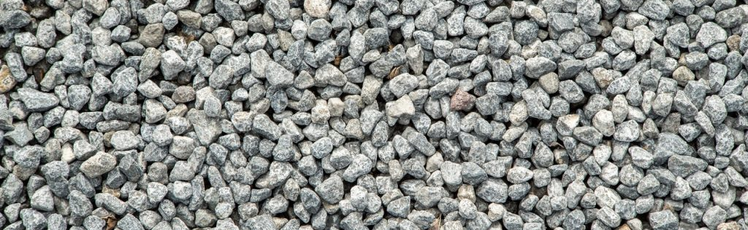
PDFs as an Aggregate
What can thousands of PDFs tell us?
Notes:
Welcome to PDFs as an Aggregate: What can thousands of PDFs tell us.

Slide 2

Patrick Gallot
Senior Solutions Architect
Notes:
Introduce myself.

Slide 3
PDF is not 1 format
It is the format of untold thousands of different applications
Each of which creates PDFs with their own quirks
Each PDF is constructed from a unique set of resources
Similarly constructed PDFs may not be identical in appearance.
PDFs that are identical in appearance are not necessarily constructed identically.
Notes:
Every PDF is its own unique pebble, different in some ways from all the others, but if examined at some remove, we can see that some have similar mineral composition, and some are less similar than others.
Looking at PDFs as an Aggregate, it becomes clear, that really PDF is not a single format, it is a bunch.
PDF is not PostScript, which means it is not a programming language that can change its own rendering. However from PostScript PDF inherits and extends a powerful set of primitives from Postscript which allows quite a bit of flexibility in constructing documents. It internally supports a number of font formats and image formats which means that pictures that look identical could be stored in entirely different ways within a PDF. Alternatively a document that is constructed the same might end up looking slightly differently because, say, the fonts may be different versions of themselves.
How does one go about finding PDFs that are internally similar or dissimilar to what you are looking for?

Slide 4
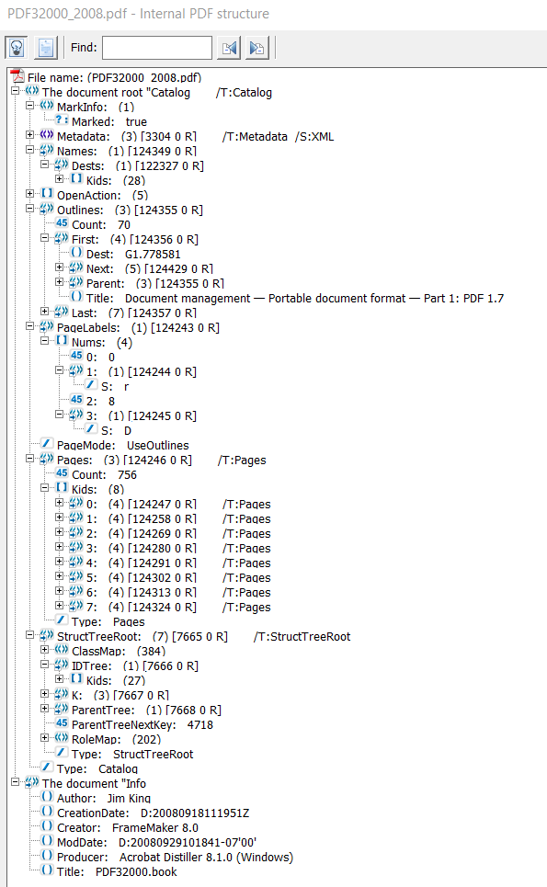
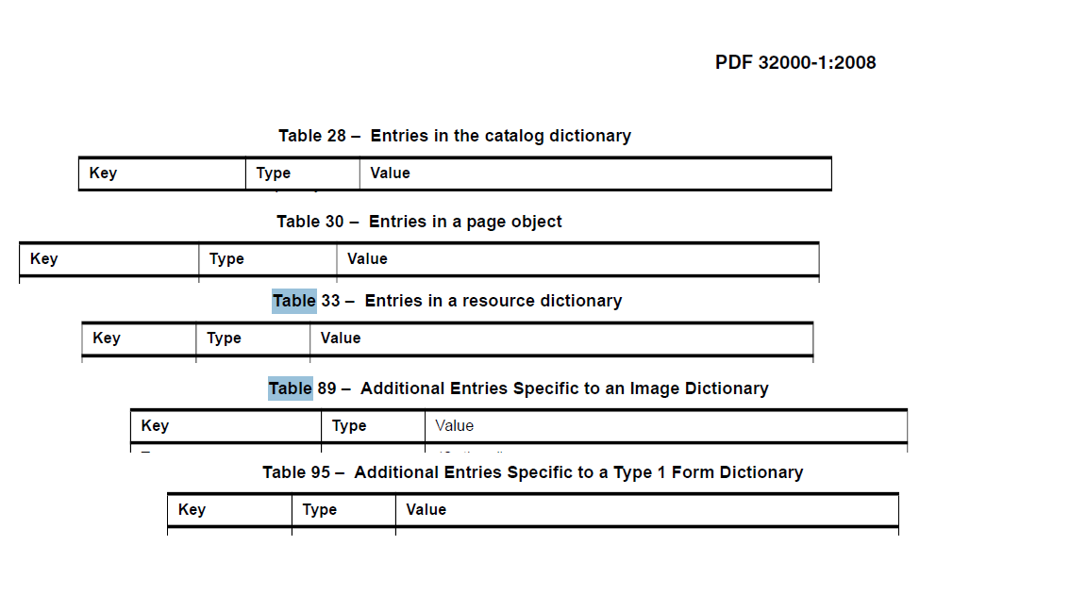
How to think about the internal structure of PDFs?
Notes:
As PDF developers, we are used to thinking of the internals of PDFs as being a tree or a collection of trees rooted in the Catalog dictionary.
But if you read the PDF specification…not too closely, and kind of tongue-in-cheek, you could also consider PDFs as made up of collections of Tables. As in a SQL database. This is not completely out of left fields as, the Man behind the Camelot Paper, John Warnock, codeveloped the "The Evans and Sutherland Design System" for producing 3-dimensional graphical databases both for the Evans & Sutherland CAD/CAM Picture System and for custom-built simulation machines. (https://historyofinformation.com/detail.php?entryid=1213). Once you start thinking of a PDF object collection as potentially a row entry in a database, You can externalize some of this data into an actual SQL database so that you can do various queries to find the sorts of PDFs that might have the internal features that you are looking for. So let’s look at a couple of collections of PDFs.

Slide 5
Two Collections of PDFs
Notes:
Before we proceed farther, I would like to make clear, that with this database-driven approach to analyzing a set of PDFs, We are essentially looking at document metadata in the broadest sense of the word. Specifically, We are strictly looking at 1. Document Metadata 2. Structural elements of the documents and 3. Errors triggered while parsing the documents. No page content is being captured in these databases. Nor will we be sharing anything that might remotely be considered sensitive or a privacy issue.

Slide 6
number of files | SELECT COUNT(*) as file_tally FROM FILEINFO
Total Filesize | SELECT SUM(FILESIZE) FROM FILEINFO
average filesize | SELECT AVG(FILESIZE) FROM FILEINFO
Distinct Producers | SELECT COUNT(*) as producer_tally from (select DISTINCT PRODUCER FROM DOCINFO)
date of most recent file | SELECT CREATIONDATE from DOCINFO ORDER BY CREATIONDate Desc limit 25
date of least recently modified | SELECT MODDate,CREATIONDATE From DOCINFO where MODDate !='' ORDER by MODDate DESC limit 25
oldest creation date | SELECT DISTINCT CREATIONDATE from DOCINFO ORDER BY CREATIONDate ASC limit 25
unique IDs | SELECT COUNT(Distinct INST_ID) FROM FILEINFO
null UIIDs | SELECT Count(*) FROM FILEINFO where INST_ID is '' or INST_ID is null
unencrypted PDFs | SELECT COUNT(*) as unencrypted_tally from FILEINFO WHERE SECURED=0
Unencrypted, No Errors detected: | SELECT COUNT(*) as errorfree_tally from FILEINFO where SECURED=0 AND rowid not in (select distinct DOCID from ERRORS)
files with errors | SELECT COUNT(*) as badfile_count from (select DISTINCT DOCID FROM ERRORS)
Exceptions recorded: | SELECT COUNT(*) as errorcount FROM ERRORS
PDF/A files | SELECT COUNT(*) as pdfa_tally from XMPIDs WHERE pdfaid_part is not null
PDF/UA files | SELECT COUNT(*) as pdfua_tally from XMPIDs WHERE pdfuaid_part is not null
PDF/X files | SELECT COUNT(*) as pdfx_tally from XMPIDs WHERE pdfxid_GTS_PDFXVersion is not null
AcroForm PDFs | SELECT COUNT(*) from FILEINFO where rowid in (select distinct DOCID from ACROFORM WHERE Fields is not null GROUP by DOCID)
potentially signed | SELECT COUNT(*) as sigflags_tally from FILEINFO,ACROFORM where FILEINFO.rowid=docid and SigFlags>0
tagged PDFs | SELECT COUNT(*) as tagged_count from CATALOG where StructTreeRoot is not null and MarkInfo is not null
PDFs with NameTrees | SELECT COUNT(*) as nametree_tally from NAMETREE
Notes:
Also, a certain number of files are excluded from these databases. The most important exclusion is that they have to be openable as PDFs with APDFL. This excludes a number of damaged files, but also files that require a password to be opened, and Adobe encrypted eBooks. Also, this is a toggle in my tool, but XFA PDFs are excluded from this set of databases.

Slide 7
number of files | 67,472
Total Filesize | 64,265,618,607 | 59.85GB
average filesize | 952,478.34 | 0.91MB
Distinct Producers | 2,099
date of most recent file | 3/9/2020
date of least recently modified | 10/5/1994
oldest creation date | 2/18/1994
unique IDs | 24,511 | 36.33%
null UIIDs | 1,397 | 2.07%
unencrypted PDFs | 66,816 | 99.03%
Unencrypted, No Errors detected: | 63,568 | 94.21%
files with errors | 3,275 | 4.85%
Exceptions recorded: | 117,509
PDF/A files | 533 | 0.79%
PDF/UA files | 45 | 0.07%
PDF/X files | 902 | 1.34%
AcroForm PDFs | 5,232 | 7.75%
potentially signed | 1,716 | 2.54%
tagged PDFs | 3,411 | 5.06%
PDFs with NameTrees | N/A | #VALUE!
number of files | 11,246
Total Filesize | 22,414,557,390 | 20.88GB
average filesize | 1,993,113.76 | 1.90MB
Distinct Producers | 2,322
date of most recent file | 10/7/2019
date of least recently modified | 2/19/1998
oldest creation date | 2/15/1996
unique IDs | 7,850 | 69.80%
null UIIDs | 2,433 | 21.63%
unencrypted PDFs | 10,940 | 97.28%
Unencrypted, No Errors detected: | 10,349 | 92.02%
files with errors | 610 | 5.42%
Exceptions recorded: | 79,029
PDF/A files | 366 | 3.25%
PDF/UA files | 27 | 0.24%
PDF/X files | 144 | 1.28%
AcroForm PDFs | 1,243 | 11.05%
potentially signed | 315 | 2.80%
tagged PDFs | 1,997 | 17.76%
PDFs with NameTrees | 852 | 7.58%
Notes:
The two collections are going to be color-coded: Orange for files that are largely either internally generated or came from customers reporting issues involving products we support over the course of many, many years. Blue largely coming to us via our WebDemos, so from random folk from around the internet. The internal collection has 6 times as many files, but on average they are about half as small as the external PDFs. Note that these sets have constructed in such as way as to exclude obvious duplicates based on document’s unique IDs, but these are optional and no cryptographic hashes were calculated to bring that number down further. The one surprising thing from comparing these two collections in this way is that the external repository’s percent of tagged PDFs is roughly three times higher than the files from the internal repository. Are these collections different in other ways?

Slide 8
SELECT PDFVersion,count(*) FROM FILEINFO GROUP BY PDFVersion ORDER by PDFVersion
PDF Versions

Slide 9
Notes:
The files that come from our inside file set skew overwhelmingly towards version 1.6, which is the default for APDFL; while the files from our outside sources show more of a bell-curve distribution with most being version 1.4.

Slide 10
SELECT pdfaid_part, pdfaid_conformance, count(*) as tally from XMPIDs where pdfaid_part is not null group by pdfaid_part, pdfaid_conformance
PDF/A versions

Slide 11
PDF/A Versions
Notes:
The dominant flavor of PDF/A for both repositories is still PDF/A-1b, though the outside repository seems to have more examples of newer versions of PDF/A both on an absolute and relative basis.

Slide 12
PDF Producers
Notes:
PDFs as Aggregrate… both inside and external repository, have over 2000 distinct PDF Producers, even though one is about 5-6 times larger than the other… so Which are the most common ?

Slide 13
SELECT PRODUCER, count(*) as tally from DOCINFO GROUP by PRODUCER ORDER by tally DESC LIMIT 25

Slide 14
Notes:
Looking at the most common PDF Producers, our inside file set is skewed heavily with Adobe-producers. There’s a fair amount of that in the outside file set, though the most common Producer is an unspecified producer followed by Microsoft Word edging out the Adobe PDF Library.
Again, this is not necessarily statistically representative. The same query run against the “Issue Tracker” PDF corpus put together by Tika is very much dominated by versions of LibreOffice. Interestingly enough, their set of 20000 files is roughly in between our two corpa, and they also have around 2k-some distinct PDF Producers, just not the same mix as here.

Slide 15
More Methodology: Detecting errors in PDFs
Why detecting errors is important and useful?
Addressing errors helps other PDF consumers down the line.
Reduces frustration and time loss trying to fix PDF documents.
APDFL has several APIs for reading information from a PDF…
Call them all, log the exceptions in the database, along with the function that triggered the exception, and the objectID of the function parameter in the database.
Notes:
The Adobe PDF Library is essentially a swiss-army knife –type collection of functions for handling different aspects of PDFs, which our customers use to build different specialized tools for their customers. Most customers won’t use all of the functionality of the product, but by calling all of these functions that read information from PDFs, we can detect if a particular file might be problematic for somebody using that functionality. By capturing the function called and the object ID of the Parameter being acted on, we can better hone in on the problem.

Slide 16
Most Common Errors
SELECT ERRORS.ERRORCODE, MESSAGE, count(*) as tally from ERRORS, ERRORCODES where ERRORS.ERRORCODE=ERRORCODES.ERRORCODE GROUP BY ERRORS.errorcode ORDER BY tally, errors.errorcode

Slide 17
Most common errors
Notes:
This is an analysis of the errors found examining the files of the external repository, which somewhat surprisingly had about the same error rate as the internal repository (though this repository had a good number of PDF files, uhm, disqualified by our virus scanners). By Far the most common error has to do with incorrectly tagged PDFs. But the most notable feature of this list of the top 25 most common error messages was how generic the error messages are.

Slide 18
Errors by Function
SELECT FUNCNAME,COUNT(*) from ERRORS GROUP BY FUNCNAME order by funcname
Notes:
TODO: Describe this query a bit better.

Slide 19
Errors by function
Notes:
This list is a bit more interesting. The worst offender is PDSElementGetKidWithMCInfo, which is a function for reading the tagged structure tree from the PDF, but there are a few other related functions for handling tagged PDFs that show up in this list. There also seem to be some issues with Fonts and text extraction, some issues with Images and colorspaces. The next question is: are these issues widespread or primarily affecting particular files. But before I go there, let’s take a different tack for a bit.

Slide 20
Looking for Objects that trigger more than one exception.
SELECT ERRORs.ERRORCODE, count() as tally, message, docid, objectid, funcname from ERRORS,ERRORCODES where ERRORS.ERRORCODE=ERRORCODES.ERRORCODE GROUP BY docid, objectid, ERRORs.ERRORCODE, funcname having tally > 1 order by tally, docid desc
Notes:
With this query, we are looking for Documents with indirect objects that trigger different exceptions for the same indirect object. Which typically occurs when the object is passed to a different function which handles the object differently. On the next slide, I’ve matched up some of these errors side-by-side to give you a flavor of that…

Slide 21
Malformed objects can trigger different errors in different API calls.
PDEEnumElements: there were too many arguments.
PDEEnumElements: Non-hex character in a hex string.
PDEEnumElements: Unterminated string.
PDEEnumElements: Expected a name.
PDEFormCreateFromCosObj: Bad parameter.
PDEFormCreateFromCosObj: Bad parameter.
PDEFormCreateFromCosObj: Bad parameter.
PDEFormCreateFromCosObj: Bad parameter.
Notes:
Essentially, it seems that PDEFormCreateFromCosObj will complain “Bad Parameter” for pretty much any issue in the Content Stream of an indirect Object while enumerating the elements of that content stream gives a more fine-grained picture of the issue.
End-of-sidebar, back to where we were on whether these errors widespread or just massively affecting particular files, let’s consider the next query.

Slide 22
Document count of Functions triggering Errors
SELECT FUNCNAME, COUNT(DISTINCT DocID) from ERRORS GROUP BY FUNCNAME order by funcname
Notes:
Essentially, in how many documents did we see at least one error for a particular function call?
Note that for the next slide, the list of functions is actually going to be ordered by count rather function name. The sorting was done in Excel rather than via the SQL query.

Slide 23
Document count of Functions triggering Errors
Notes:
Here the picture changes quite a bit from what we saw 4 slides ago. PDEEnumElements is triggering exceptions in the most documents. Exceptions from this call most likely reflect problems in the content streams of Pages and Form XObjects. Likewise, we are seeing WordFinder as more widespread exceptions. And problems with tagged PDFs drop more towards the middle of the Pack.
The next step in this progression is: what happens if you forgive small errors, like missing required entries where you might be able assume a reasonable default, for example? How does this picture change?

Slide 24
Errors of allowing relaxed syntax on exceptions, by document
Notes:
The Most dramatic effect of allowing a relaxed syntax is on PDEFontGetAttrs, so on font attributes, which likely has a carry-over effect on PDFFontFromCostObj, and on Text Extraction, though curiously PDEFontCreateFromCosObj exceptions actually go up with relaxed syntax.
With Relaxed syntax turned on, the same files processed had 88 more files where no errors were reported. The percentage of files with errors dropped from 5.4% to 4.6%, a decrease of around 14%. However, the total error count recorded went up by nearly 2600, an increase of about 3.3%
TODO: Summarize this sequence.

Slide 25
Trends & Final Thoughts
Document error rates might trend downward…
But defect-free PDFs as an aggregate will probably always be out of reach.
But reducing errors in documents helps extends their useful life.
Tagged PDFs are growing in importance.
But PDF/UA so far seems to have a much slower adoption rate.
PDF/A is also growing in Importance.
PDF 2.0? Not so much in this dataset.
Notes:
My opinion from looking at the repositories and comparing. The internal reposity is smaller, but newer. Older repository has more inertia to it.

Slide 26



How can you streamline and automate this?
Ensure that your input files are
checked and fixed before consumption
Leverage scriptable server tools in your workflows that can automate processes
Notes:
TODO: Transition to discussing PDF Checker?

Slide 27
Scan your PDFs for Errors
Analyze your PDFs
There can be many issues lurking within your PDF files
Could impact the ability and reliability of tools and software to view or process PDF files
Can cause a negative impact on end users interacting with your PDFs
Use a tool that can be automated to analyze multiple PDF files.

Slide 28
Assess what can be fixed
2. Assess problems found from your analysis
Gain insight about how your PDFs are structured
Decide on what to do next with your PDF files
PDF can be further optimized
Contains metadata
Contains transparencies
Uses fonts not embedded

Slide 29
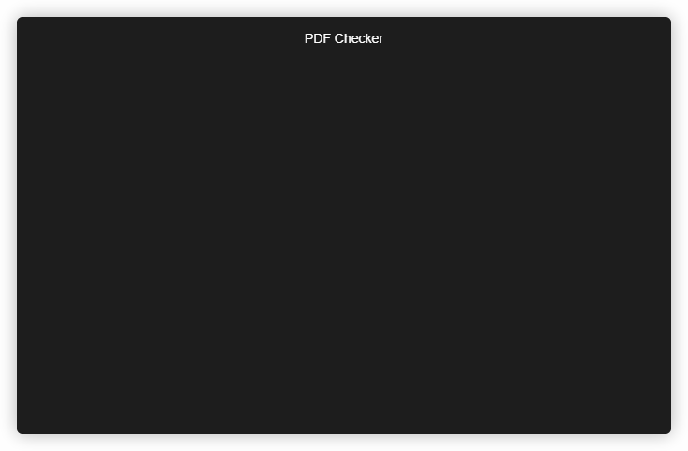
Scanning your PDFs with PDF Checker
Checks that can be completed:
Optimization assessment
Check for conformance to: PDF/A, PDF/E, PDF/UA, PDF/VT, PDF/X
Metadata
Font analysis
JavaScript
Color and image resolution

Slide 30
Resolve your PDF Errors with PDF Checker + PDF Optimizer
3. Fix PDF errors with PDF Optimizer
PDF Optimizer can fix many issues flagged by PDF Checker
PDF Optimizer is a powerful tool that provides fast processing speeds and offers user-specific optimization profiles
Customizable PDF capability needs such as:
Optimal PDF size reduction
Optimize PDFs for viewing and printing
Archive PDFs for long term preservation

Slide 31
Resolve your PDF Errors with PDF Checker + PDF Optimizer
Our PDF Checker tool now comes with a FREE 14 day trial of PDF Optimizer
PDF Checker now offers JSON report output capabilities streamlining the process for programmatically driving PDF Optimizer processes based on conditions reported by PDF Checker enabling you to have more power over your PDFs.
Go to www.Datalogics.com to get your FREE PDF Checker download!

Slide 32







Who is Datalogics?
Established in 1967
Located in Chicago
Providing Adobe PDF toolkits to developers since 1997
Active in the Developer Community
Member of the PDF Association
Notes:
-mention that is our old logo

Slide 33

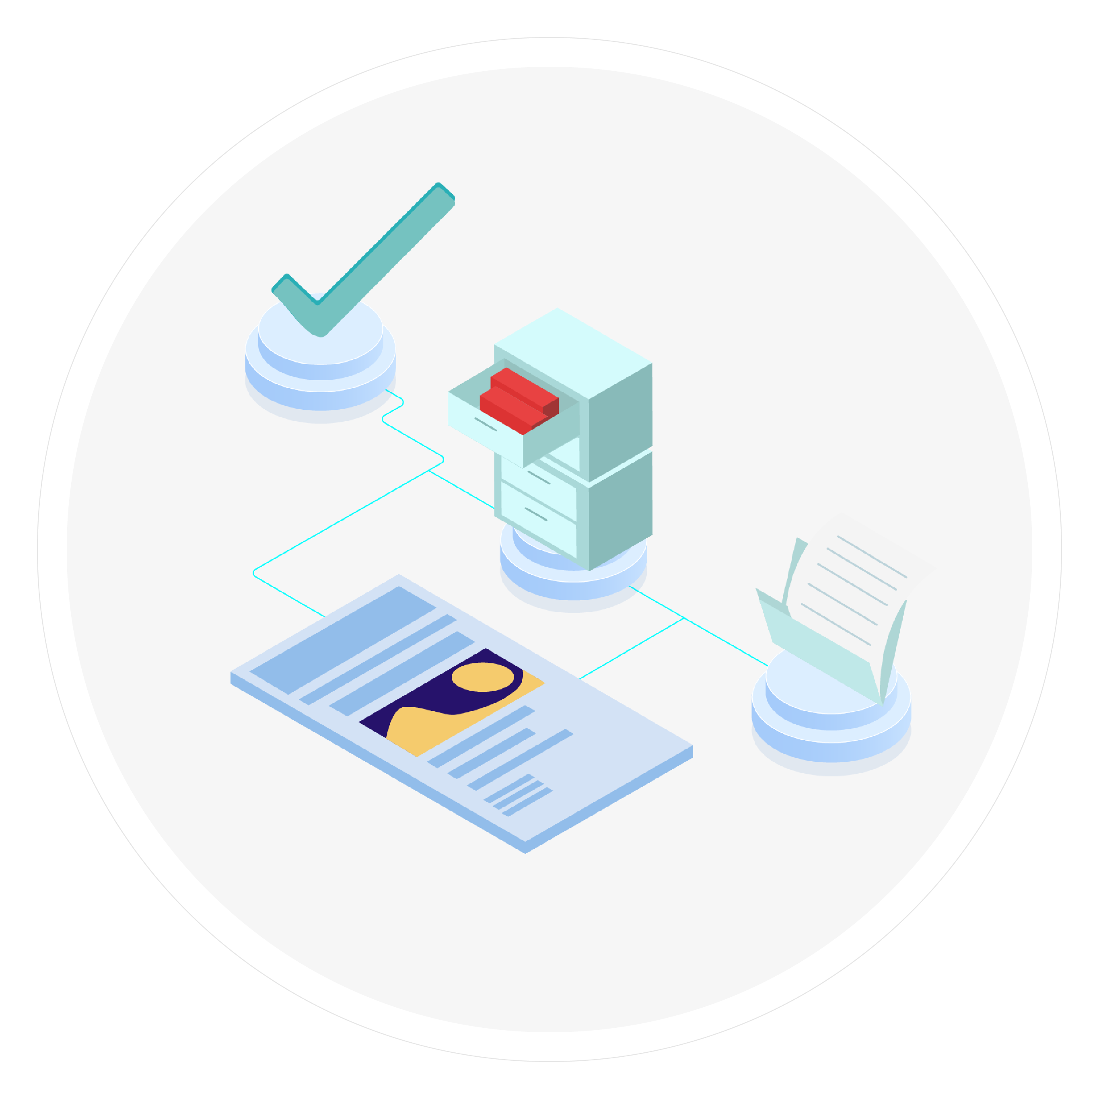


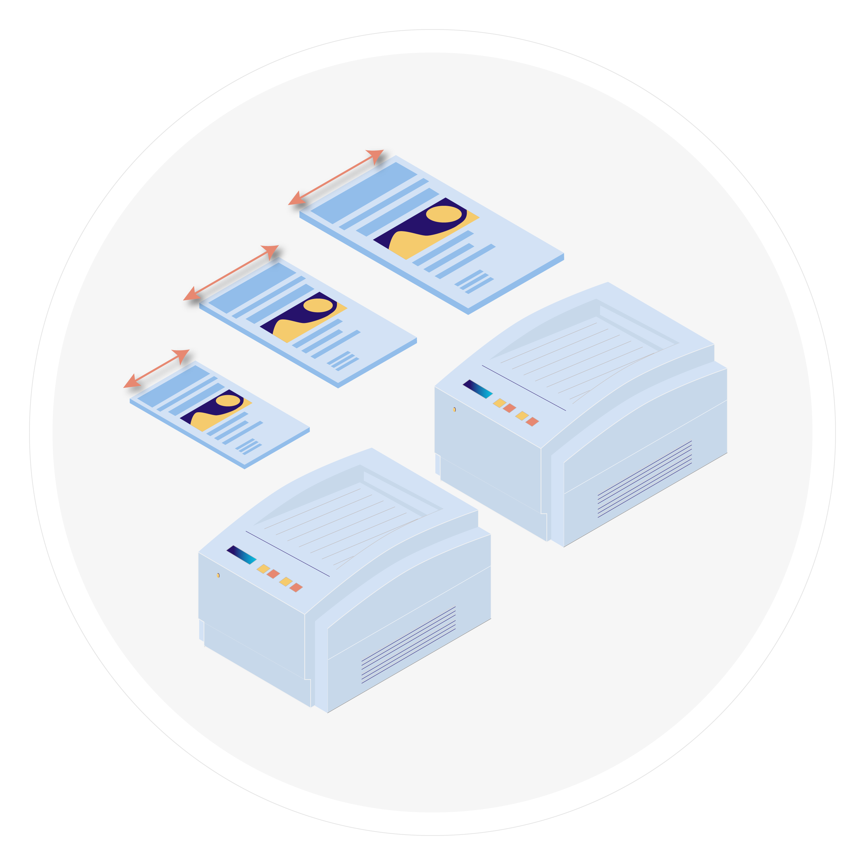





Full Suite of Scriptable Server Tools & SDKs
PDF Checker
Identify common problems with your PDF files
PDF Optimizer
Reduce file size, enable archival compliance
FLIP2PDF
Easily convert PDF files to a variety of filetypes
PDF2IMG
Convert PDF pages to a variety of image formats
PDF2PRINT
Automate your printing processes
PDF Alchemist
Easily convert PDFs to HTML, XML, and EPUB
PDF Forms Flattener
Flatten XFA & AcroForms to PDF
Adobe Experience Reader Extensions
Reader extend PDF documents
Software development kits
Ideal for SaaS and
OEM implementations
ADOBE PDF LIBRARY
PDF JAVA TOOLKIT

Slide 34
Q & A

Slide 35
Patrick Gallot
Senior Solutions Architect

