Slide 1
Forget the PS5
I’ve got a PDF 2.0

Slide 2

PDF 2.0

Slide 3
Who am I?
Michaël Demey
Proud Father
Software Developer
iText employee since 2011
Gamer
@MyMilkedEek

Slide 4
What is Game Development
What are games?

Slide 5
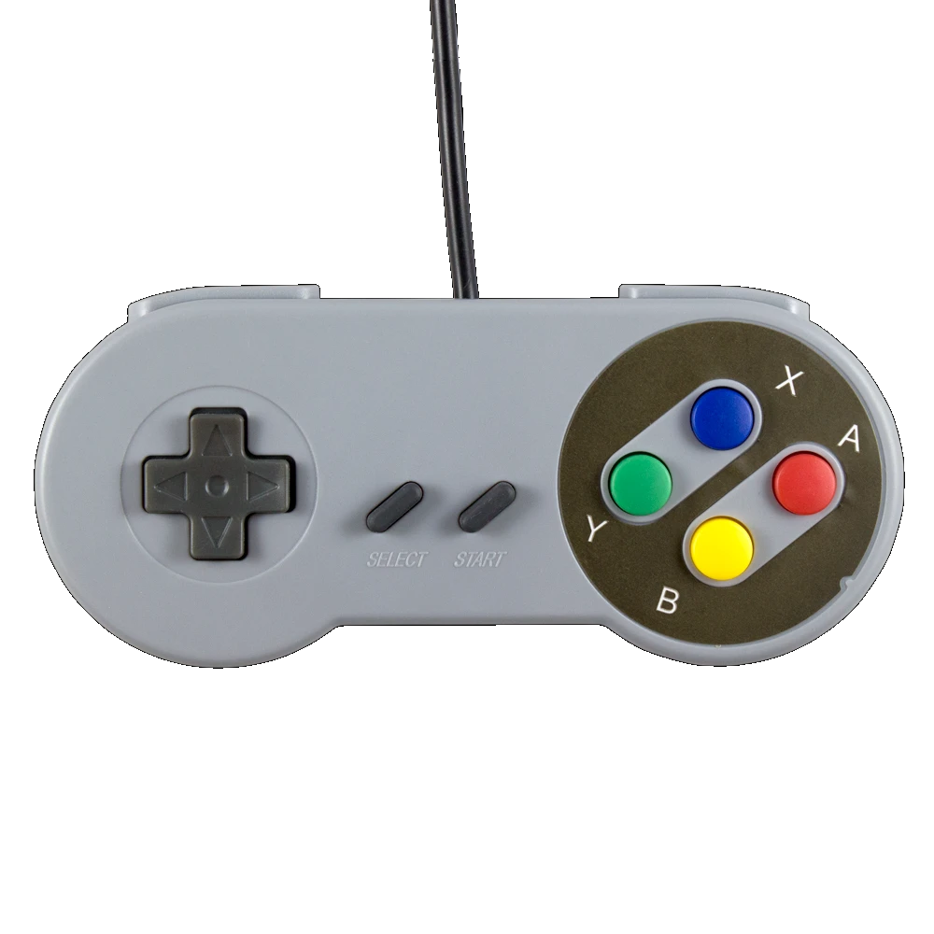
Interactive Media

Slide 6

Why hasn’t anyone made a game in PDF yet?

Slide 7

Missing features
Notes:
Javascript is supported, but no rendering instructions
No memory
No game loop
No networking! Imagine that!

Slide 8

Incompatible Tooling
Notes:
No debugging
No rendering tools
No documentation

Slide 9
But most obviously
Not really meant to be a gaming platform
Notes:
It’s as if the whole file format doesn’t agree to my wish

Slide 10

So, why did I do this?

Slide 11

Notes:
Because people are people. And people do things because they want to see if they can. Doesn’t matter if it’s useless. Take this man, climbing a column that doesn’t lead anywhere. Is it useful? Does it get him to higher ground or the other side? No. He does it because he can, because he wants to know he can do it. It just turns out that the more useless things are the most fun. On one hand we’ve got people shooting rockets to Mars and having the boosters land autonomously and that is so cool. But then on the other hand we’ve got people trying to get DOOM to run on a toaster. And I’m equally intrigued.

Slide 12
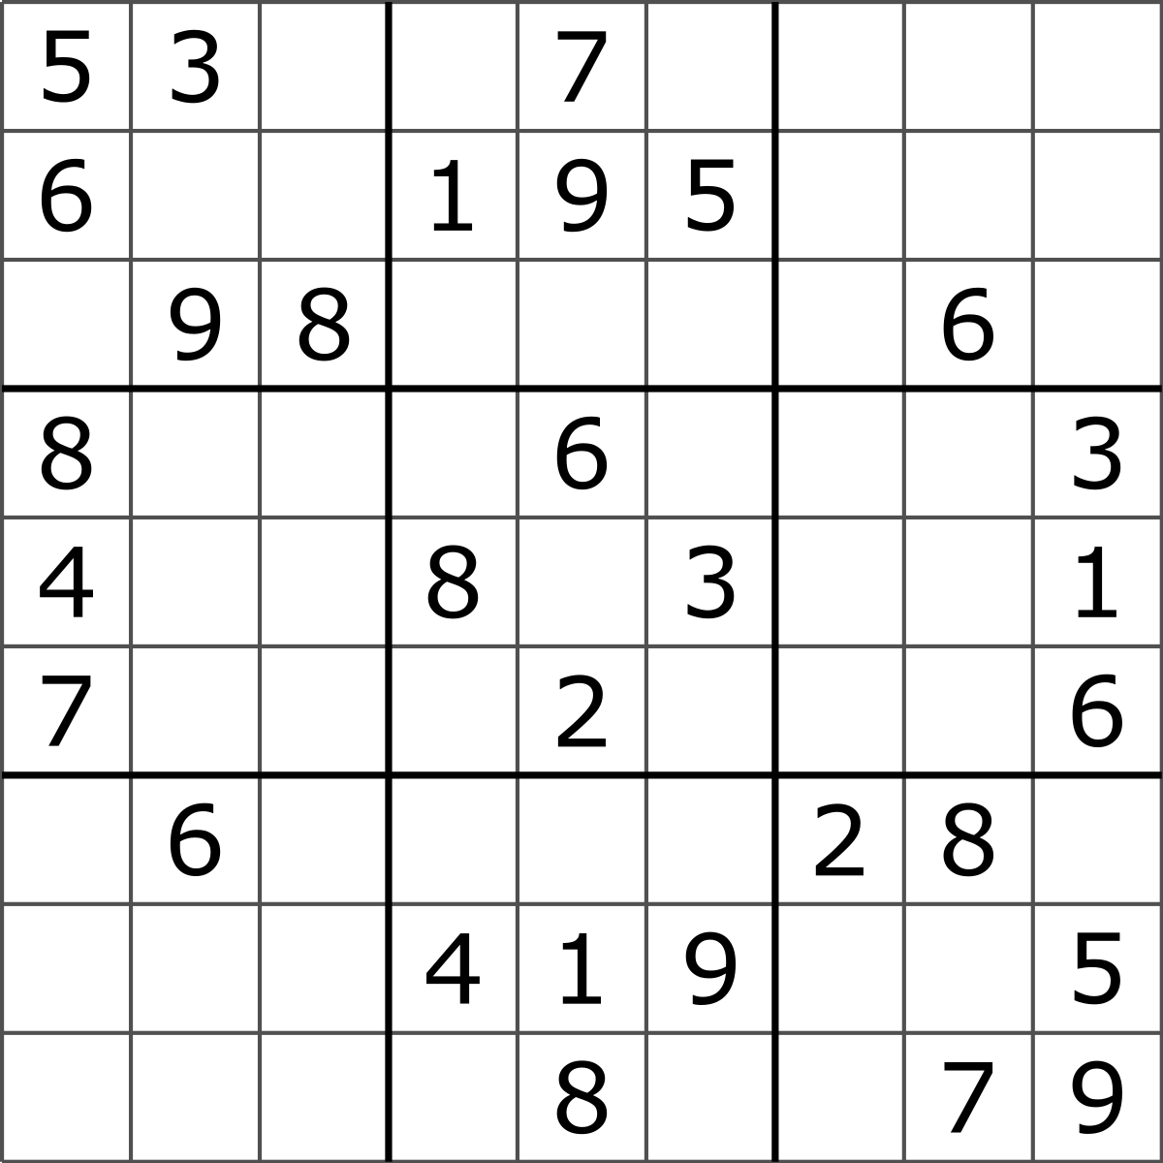
First Idea
Notes:
Easy and already worked out idea and concept
Plenty of resources
Not leaning too heavily into the JavaScript
Basically just validation of form fields
Event driven
No continuous game loop
Player action and input drives next step in the game

Slide 13
Sudoku!
2 approaches
Hardcoding
Evaluate the entered numbers
Notes:
2 approaches

Slide 14
function valid(arraySolution) { for (var y = 0; y < 9; ++y) { for (var x = 0; x < 9; ++x) { var value = arraySolution[y][x]; if (value) { // Check the line for (var x2 = 0; x2 < 9; ++x2) { if (x2 != x && arraySolution[y][x2] == value) { return false; } } // Check the column for (var y2 = 0; y2 < 9; ++y2) { if (y2 != y && arraySolution[y2][x] == value) { return false; } }
// Check the square var startY = Math.floor(y/3)*3; for (var y2 = startY; y2 < startY + 3; ++y2) { var startX = Math.floor(x/3)*3; for (x2 = startX; x2 < startX + 3; ++x2) { if ((x2 != x || y2 != y) && arraySolution[y2][x2] == value) { return false; } } } } } } return true; }
Notes:
Is what the javascript looks like
TODO: clean up slide

Slide 15
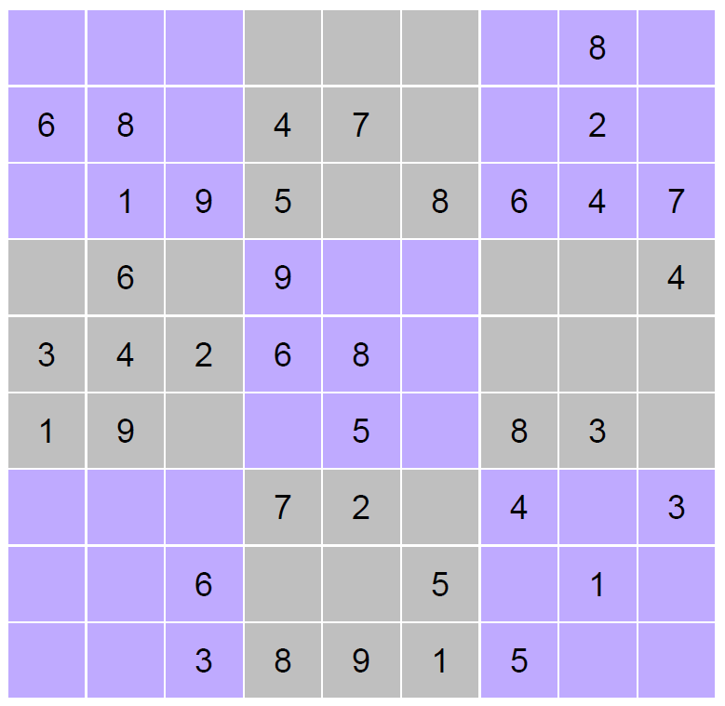
You can even make it look pretty

Slide 16

Wasn’t that a bit too easy?
Where’s the game loop?
Why can’t I just print this and fill this out when I want to?

Slide 17
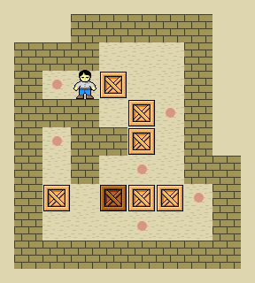
Sokoban!

Slide 18
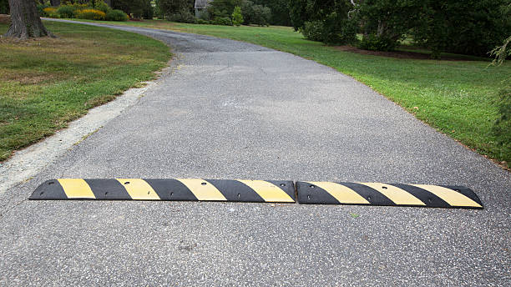
Roadbumps

Slide 19
Moving Images!
Notes:
Images don’t move in PDF
So how would you approach this?
-> BUTTONS

Slide 20

Form fields!
JavaScript allows you to manipulate the bounding box of a form field
Notes:
The api guide for javascript in PDF is clear and straight to the point; bounding boxes can be changed by a javascript function. By updating the bounding box of the “player” button form field, you can easily create the illusion of movement and interactivity. We have given the player a means of interacting with the world.
All that through a simple function that is triggered by keystrokes

Slide 21
How you move buttons in JS
var player = this.getField("player");
var rect = player.rect;
rect[0] += 20;
rect[2] += 20;
player.rect = rect;

Slide 22

Keystroke?
Notes:
How are you capturing the input?

Slide 23
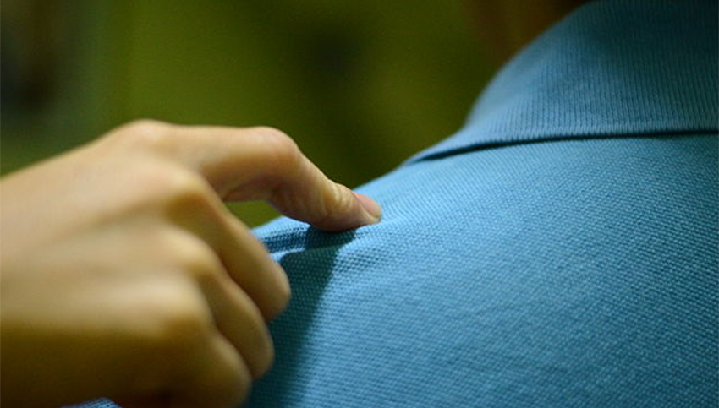
Requesting Focus
Notes:
There is a single hidden text box
When you open the PDF file, javascript triggers and gives focus to the field
Any input you give “WASD” to move, will trigger a keystroke event, which will trigger the function to move the button

Slide 24
How to request focus
this.getField(\"Controls\").setFocus();
app.fullscreen = true;

Slide 25
Tying Up Loose Ends
Easy stuff remains to finish the game
Collision detection
Victory Condition check
Level progression

Slide 26

Levels

Slide 27

Example of Programmer’s art

Slide 28

Road Ahead

Slide 29

DOOM
Benchmark for any system
Approach
Write an emulator in JS
“Screen” is a grid of buttons
Simulating pixels
This grid will render the game
Figure out sound/music

Slide 30
How to create these PDFs
Notes:
CC Alexey // keep Alexey in the loop

Slide 31

Who we are
iText is a leading technology company active in the digital documents space
Flagship product
Open source software libraries to create and manipulate PDF documents in Java and .NET (C#).
Developed in 2000, commercially available since 2008.
Customers
There are currently millions of iText users, both open source and commercial.
Software developers, technology vendors, software integrators, but also
Financial, public, government and health care sectors including many of the Fortune 500 companies.
Notes:
Today we are a fast-growing technology company active in the digital documents space. We are perceived as a leader when it comes to PDF technology
Our flagship product is the open software PDF library or SDK to create and manipulate PDF documents. As mentioned, we started off in Java, but then added .Net.
We have customers all over the world, open source and commercial. Profiles are software developers, technology vendors and software integrators…

Slide 32



iText portfolio
Enterprise-grade PDF library
Low-code technology
iText 7 Suite
iText DITO
SDK for PDF processing, PDF/A & PDF/UA creation, digital signing, security, data extraction, OCR, HTML conversion, redaction, Acroforms, XFA flattening, rendering of PDFs as images, language capabilities, typographic features, and much more.
Fast template-based document generation
Template designer
Conditional content
Data binding, and
Much more

Slide 33
How did I use iText in creating the games?
Polyvalent API
Convenience → High Level API
Very customizable → Fine tune on a syntax level
Customize the PDF as I want it
Insert Javascript

Slide 34
What is a PDF Action?
A Javascript function that can be triggered by an event
Similar to HTML/JS triggers onSubmit, etc.
Can be placed on a lot of levels

Slide 35
Creating PDF Actions with iText
PdfAction.createJavaScript( "var player = this.getField(\"player\"); var rect = player.rect; rect[0] += 20; rect[2] += 20; player.rect = rect;“ )

Slide 36
Attaching Javascript to a Field
PdfTextFormField controls = PdfFormField.createText( pdfDocument, new Rectangle(0, 0, 200, 200), "Controls", "."); controls.setAdditionalAction(PdfName.K, PdfAction.createJavaScript(javascript)); PdfAcroForm form = PdfAcroForm.getAcroForm(pdfDocument, true); form.addField(controls);

Slide 37
Removing JavaScript from a PDF
PdfAcroForm acroForm = PdfAcroForm.getAcroForm(pdfDocument, false);
PdfFormField fieldWithJavascript = AcroForm.getField("fieldWithJavascript");
fieldWithJavascript.setAdditionalAction(PdfName.K, null);

Slide 38
More convenient solutions
File htmlSource = new File("input.html");
File pdfDest = new File("output.pdf");
ConverterProperties converterProperties = new ConverterProperties();
HtmlConverter.convertToPdf( new FileInputStream(htmlSource),
new FileOutputStream(pdfDest), converterProperties);
}
https://itextpdf.com/en/products/itext-7/convert-html-css-to-pdf-pdfhtml

Slide 39

iText DITO
http://dito.online online demo

Slide 40
Q&A
Many thanks!

