Slide 1

Optimising PDF for Print, Digital and Accessible channels
A review of the challenges and solutions PDF provides for the full range of PDF use cases

Slide 2

Agenda
Challenges for PDF
Workflow for PDF
PDF Demonstration
Transform, optimize, indexing/split, re-engineering, batching/sorting, security, quality, redaction, archiving, accessibility
The Crawford Platform for PDF
Questions

Slide 3
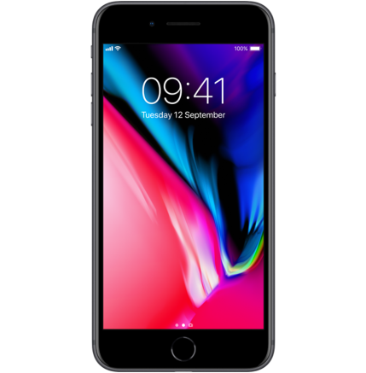
Challenges
Print
e-Delivery
Accessibility
Automation
PDF/UA
PDF/A
GDPR
Mobility
Preference
Management
Paperless
Security
360 Degree view
Platform
Redaction
Smaller Jobs
White Paper Factory
Remediate
Aging Population
The
Customer
1.3
Billion
People
Compliance
Inkjet Presses
Marrakesh Treaty
HMTL 5 Accessible
PDF Print Workflows
Equalities Law

Slide 4








Workflow
Print
e-Delivery
Accessibility
Capture/Extract
Process
Print/Deliver
Platform
Applications
Print
Composition
Accessible
Archive
ECM

Slide 5
Workflow Challenges
Print
e-Delivery
Accessibility
Platform
Archive
Suppression
Normalization
Accessibility
Re-engineering
Barcodes
Indexing
Transformation
Encryption & Signatures
Concatenation
Encryption
Redaction
Batching
Page Handling

Slide 6
Demonstration
Workflow
Batching
Page Handling
Optimization
Start
Transformation
Re-engineering
Indexing
Concatenation
Barcodes
Encryption
End
Encryption & Signatures
Suppression
Archive
Accessibility
Redaction

Slide 7
Challenges
Print
e-Delivery
Accessibility
Automation
PDF/UA
PDF/A
GDPR
Mobility
Preference
Management
Paperless
Security
360 Degree view
Platform
Redaction
Smaller Jobs
White Paper Factory
Remediate
Aging Population
The
Customer
1.3
Billion
People
Compliance
Inkjet Presses
Marrakesh Treaty
HMTL 5 Accessible
PDF Print Workflows
Equalities Law

Slide 8
CrawfordTech DTE Platform
Print
e-Delivery
Accessibility
Platform
Formats
Transform
Optimize
Indexing & Splitting
Conversion, text, image, vector, fonts
Image, fonts, page tree, resources
Re-engineering
Batching & Sorting
TLE, PPD, CSV, XMP, documents
Barcodes, pages, objects
Concatenation, re-sequencing, streaming
Security
Quality
Redaction
Signatures, encryption, passwords
Comparison of textual and bit-level
Redaction and suppression
Archive
Accessibility
??
Long term archiving and records management
Semantic tagging for assistive technology
Who knows what’s next?

Slide 9
CrawfordTech Solutions
Print
e-Delivery
Accessibility
Workflow
Dashboarding
Transform & normalize
Re-engineering
Batching & sorting
Inkjet optimization
Preference management
Quality assurance
Transpromo
Automation
Archive capture
Transform & normalize
Indexing & bursting
Archive/ECM integration
e-Presentment
Archive migration
Reprinting
Bundling & publishing
Accessibility workflow
Digital accessibility
Traditional accessibility
Accessible Paper
Transactional documents
Published documents
Site analysis
Transcription services
Technology Consulting Services
Cloud Services & Business Process Outsourcing

Slide 10
Questions
tnelms@crawfordtech.com

