Slide 1
25 Years of PDF
Richard Cohn | Adobe

Slide 2
1985 – Macintosh & LaserWriter

Slide 3
1985 – “Distillery”

Slide 4
1989 – Display PostScript

Slide 5
1989 – Font Wars!
“the biggest bunch of garbage and mumbo-jumbo I’ve ever heard”
https://allaboutstevejobs.com/bio/key_people/john_Warnock
Notes:
While Adobe was working on delivering more PostScript printers and Display PostScript, Apple and MS were also busy

Slide 6
1990 – Adobe’s Response

Slide 7
1990 – Camelot
Our vision … capture documents from any application, send electronic versions of these documents anywhere, and view and print these documents on any machine.
If this problem can be solved, then the fundamental way people work will change.

Slide 8
December 1990 – World Wide Web
Notes:
Web anniversary - 25 years 4/22

Slide 9
January 1991 – Editable PostScript

Slide 10
1991 – Interchange PostScript requirements
PostScript imaging model ++
Declarative, not interpreted
Self-contained (single file)
Solve the font problem
Multi-page
Fast viewing on current computers
Secure
Device, platform, OS, application, and resolution independent
Compact
Create from any application
Searchable
Editable
Publicly documented
Any third party can generate without patent encumbrances
Human readable
Multimedia
Interactive
Maintain structure and semantic information
Build on Adobe Illustrator 3 file format
…

Slide 11
December 1991
Focus on view and print
No more “Editable PostScript,” “Interchange PostScript”
Real team, real schedule
Notes:
Team formed

Slide 12
April 1992 – What file format?
V1: Bitmaps, multi-page Illustrator: Summer 1990–April 1991
V2: Document Management System: April 1991–April 1992
V3: PDF/Cos: April 1992–
Notes:
Peter

Slide 13
PDF 1.0 Features
PostScript imaging model
Declarative language
Portability
Random access
One-pass creation
Incremental update
Notes:
Goals: work with single-pass printer driver, constant time open of first page, constant time update, robust w/unreliable transport, PS w/o the language (basic objects, filters), less focus on imaging operators, simple tools for manipulating files
Comdex Best of Show 1992

Slide 14
April 22, 1993 – NCSA Mosaic

Slide 15
June 1, 1993 – PDF 1.0
Notes:
Story about getting reference manual done
Why PDF – not Adobe PDF, not …

Slide 16
June 11, 1993 – Acrobat 1.0

Slide 17
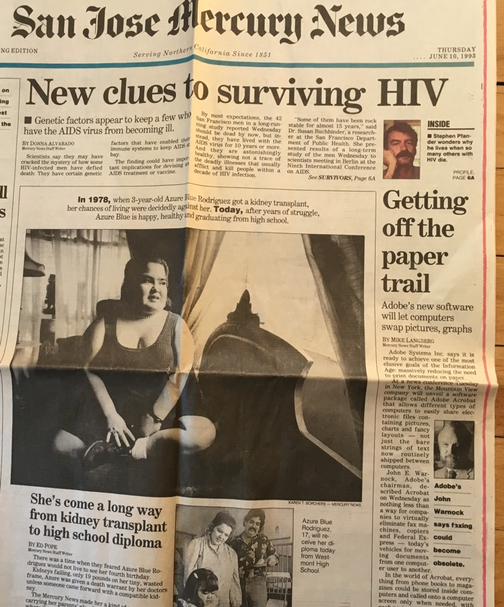
June 1993 – Front Page News

Slide 18
June 1993 – Wall Street Journal

Slide 19
January 1994 – DOS Reader
Adobe’s only DOS application
Minimum memory: 1 Mb
Notes:
Googling for PDFs (but pre-Google)

Slide 20
November 1994 – PDF 1.1, Acrobat 2.0
7 Unixes, OS/2
Weblinks (Acrobat 2.1)
Free Reader

Slide 21
December 1994 – Netscape Navigator 1.0

Slide 22
1996 – US Internal Revenue Service
IRS web site:
PDF
PS
PCL
SGML

Slide 23
November 1996 – PDF 1.2, Acrobat 3.0
Byte serving (HTTP 1.1)
Netscape plug-in
Forms
Prepress features
Japanese fonts (3.5)
Zlib/Flate – incompatible!
Notes:
Versioning

Slide 24
1999 - 2018
Year | Release | Features
1999 | PDF 1.3 | Prepress, logical structure, annotations, JavaScript, digital signatures
2001 | PDF/X | Prepress digital data exchange
2001 | PDF 1.4 | Transparency, tagged PDF, XMP
2003 | PDF 1.5 | Object streams, layers, XFA
2005 | PDF/A | Archival
2005 | PDF 1.6 | OpenType, embedded files, 3D
2006 | PDF 1.7 | Portable collections
2008 | ISO 32000-1:2008 | Standardization of PDF 1.7
2008 | PDF/E | Engineering
2009 | Adobe Ext Level 3 | Portfolios (Flash/SWF)
2010 | PDF/VT | Variable data and transaction printing
2012 | PDF/UA | Universal accessibility
2017 | PDF/Raster | Scans
2017 | ISO 32000-2:2017 | PDF 2.0
Notes:
Why ”PDF”? Why 1.x?
2003 – Jim Meehan – object streams, C++ -- “call Richard”
2009 – SWF documentation

Slide 25
PDF’s Original Success
Technical:
Features/quality
Performance
Any app, many platforms
Distribution via the Web
Non-technical:
Public specification
Free Reader
Adobe brand
John Warnock
Notes:
Black & white box

Slide 26
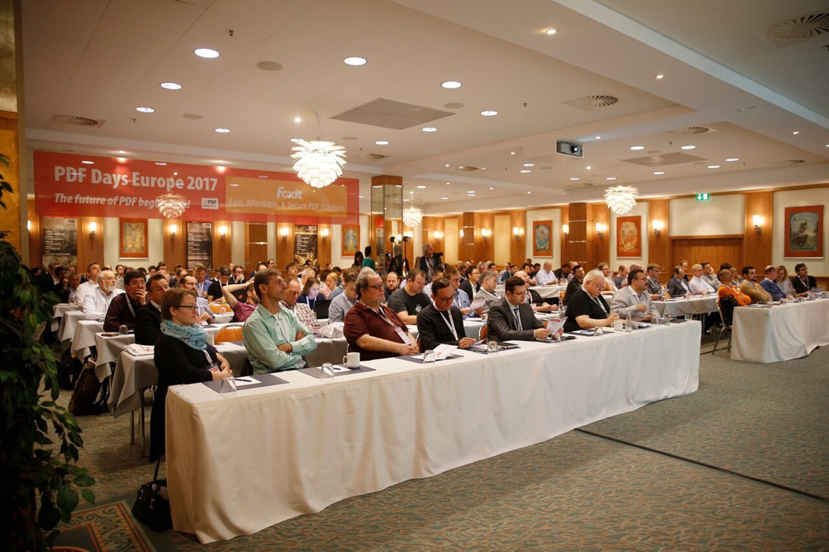
PDF’s Success Today
Shift to electronic documents
Continued need for a reliable format for exchange and archiving
ISO standards
Community

Slide 27
PDF’s Challenges for the Future
Stay tuned tomorrow …

