Slide 1
PDF Days Europe 2017
The Accessibility Game Changer
Adam Spencer
Head of Accessibility Services – Accessibil-IT Inc.
1

Slide 2

History of PDF Accessibility

Slide 3
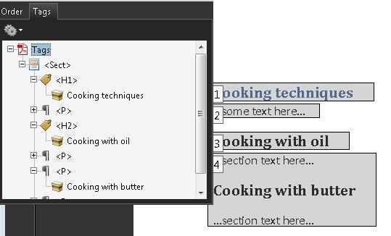
PDF/UA
The Current Standard in PDF Accessibility

Slide 4

PDF/UA
What Challenges Remained?
Developers
End Users

Slide 5

You Spoke…
We Listened

Slide 6

Usability and Interoperability Is Priority Number 1

Slide 7
The Old Way…

Slide 8
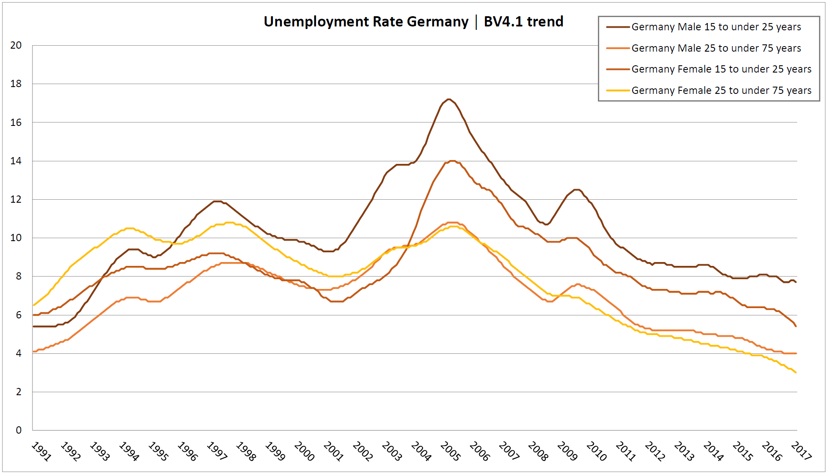
Charts

Slide 9
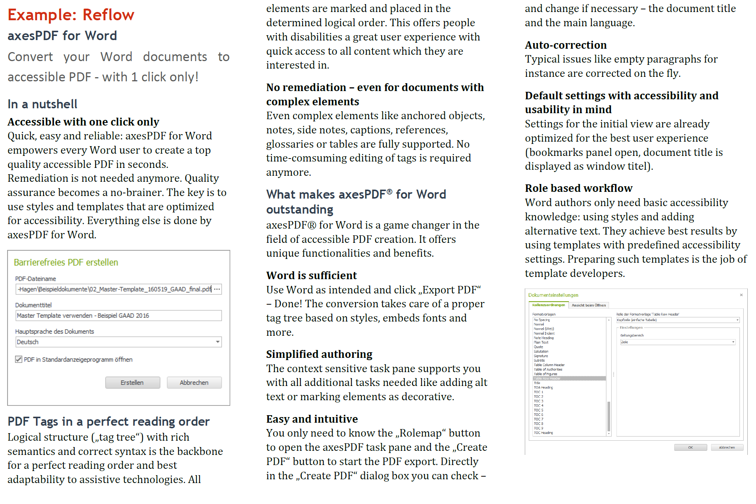
Reflow

Slide 10
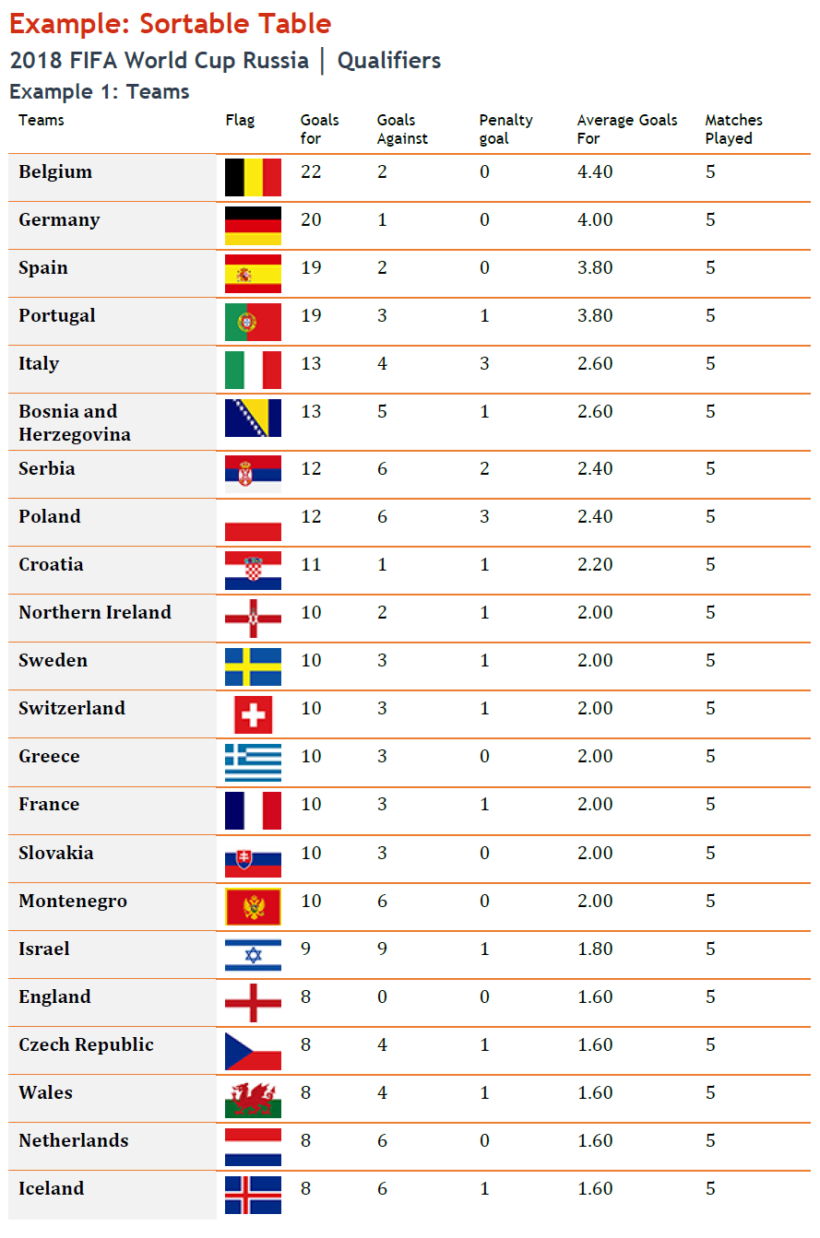
Table Sample 1

Slide 11
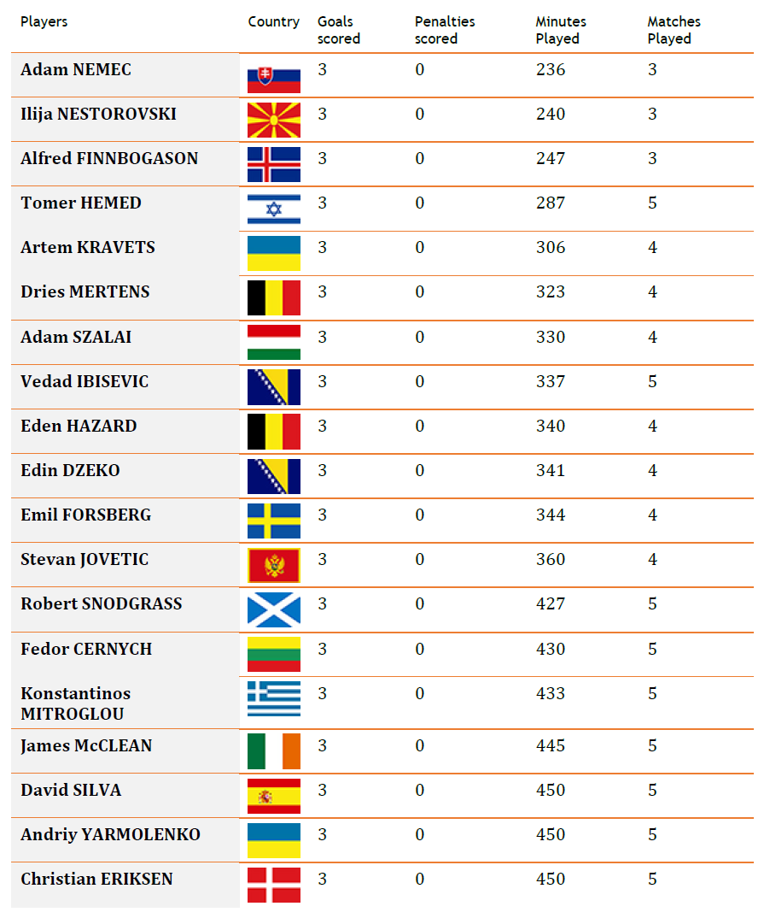
Table Sample 2

Slide 12


Slide 13
PDF Days Europe 2017
Thank you! Any questions?
Get in touch: aspencer@accessibilit.com
Web site: www.accessibilit.com
Twitter: @accessibilit
13

