Slide 1
PDF Days Europe 2017
REST API for Mobile Devices
Christoph Burkhalter PDF Tools AG Developer
Marco Grossi iLovePDF Developer and CEO

Slide 2
PDF Days Europe 2017
PDF Webservice for Mobile Devices
Christoph Burkhalter PDF Tools AG Developer

Slide 3
About PDF Tools AG
COMPANY
PRODUCTS
CUSTOMER
In the market since 1994
Since 2002 as pdf-tools.com
Server based PDF software for all common platforms
OEM Integrators IT Departments
Co-Founder PDF Association
Chair Switzerland Chapter
Member ISO Working Group 171
High Performance
High Volume
High Quality Software
More than 4000 customers in over 70 countries
2017-05-15
A PDF Association Presentation · © 2017 by PDF Association · www.pdfa.org

Slide 4
PDF in the Mobile World
Mobile is different

Slide 5
PDF in the Mobile World – Mobile is different
More mobile users than desktop users and the gap is still growing
Users spend more time on mobile devices than on other connected devices

Slide 6
PDF in the Mobile World – Mobile is different
Hardware resources are more limited on mobile devices, CPU architecture is different (ARM vs x86).
Mobile devices use other Operating Systems than Desktop or Server machines.
The User Interface is touch oriented and screens are much smaller compared to desktop devices.
User are more lenient towards Mobile Apps, accept some restrictions more easily in contrast to Desktop applications.

Slide 7
PDF in the Mobile World – Mobile is different
Developer view
High investment to switch to mobile platforms
Experience need to be gained for mobile frameworks in development, build and release processes
Limited existing applications and libraries

Slide 8
PDF Webservice
Mobile Apps and the Cloud

Slide 9
PDF Webservice – Multitude of advantages
Heterogenous system, use all your existing applications and code
Use your experience (technology, systems, applications)
‘Unlimited’ power and resources
Maintenance and Bug detection is simplified since the vendor has access to the servers
Existing and easy Update mechanism

Slide 10
PDF Webservice – Connection challenges
Internet connection is required
Documents must be transmitted to and from the service
Security must be ensured when data is transmitted and processed outside the device
Privacy is important. Specially for enterprise customer privacy must be ensured and the vendor must be trustworthy

Slide 11
Pocket PDF
Mobile App

Slide 12
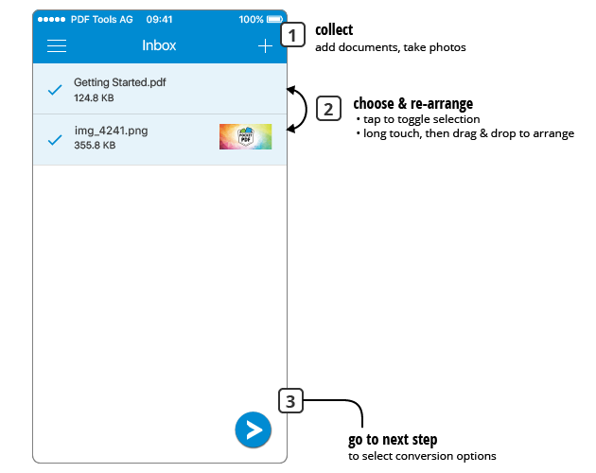
Pocket PDF – Mobile App

Slide 13
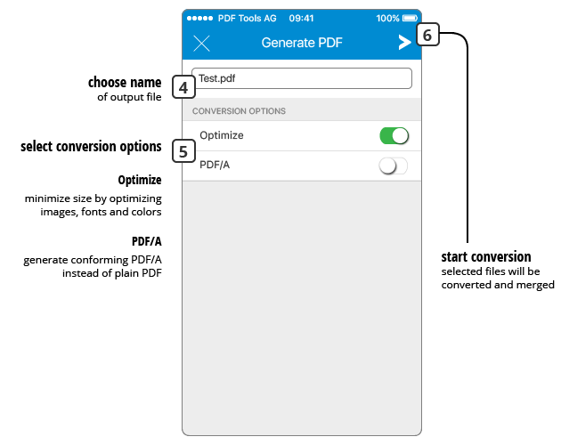
Pocket PDF – Mobile App

Slide 14
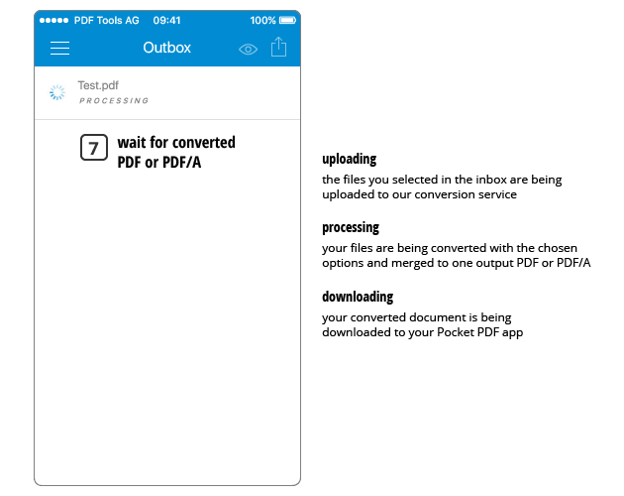
Pocket PDF – Mobile App

Slide 15
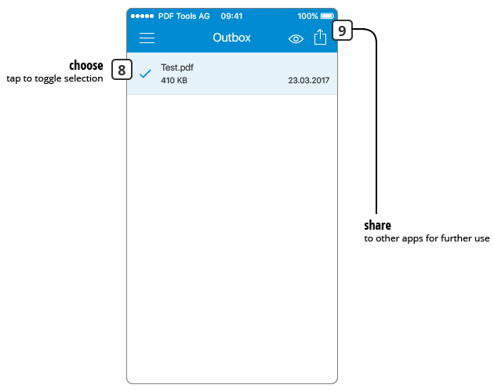
Pocket PDF – Mobile App

Slide 16
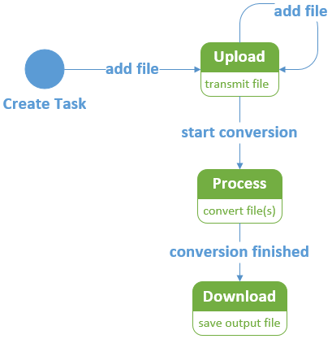
Mobile App – Process

Slide 17
Mobile App – Challenges
Connection interruptions
WIFI versus Mobile data
Large documents
Compress documents
Transmit documents in chunks
Error Handling
Anything that can go wrong, will go wrong

Slide 18
Mobile App – Opportunities
Clean interface between Mobile App and the Webservice
Customizable
e.g. Company logo, Design
Extendable
OCR
Signatures, Signing Service
Archive solution
... many more ...

Slide 19
PDF Days Europe 2017
Challenges in making a high volume Rest API for cloud PDF Processing
Marco Grossi iLovePDF Developer and CEO

Slide 20
The iLovePDF story
I'm Marco Grossi, developer and founder of iLovePDF
iLovePDF is a webapp that gives you easy access to PDF modification and conversion tools
Since 2010
No investment
I originally built iLovePDF to overcome my own PDF challenges
We now serve more than 4 million users every month, spread across the world
Top 3.000 most visited website
While iLovePDF makes working with PDFs easy as a consumer, as a developer there were still huge challenges

Slide 21
Moving from consumers to developers
Architecture limitations (as in mobile devices)
There is no easy API Rest to work with PDFs
My own users and developers have been asking for a cloud API for years
For high volume tasks using a webapp can be tedious
Not to mention we need this API for our own work at iLovePDF!

Slide 22
Challenges of high volume PDF processors
Building and maintaining processing infrastructure
PDF file security
Building and maintaining software across variety of modification types
Making software development easy
Conclusions

Slide 23
First challenge: Infrastructure
Main challenges:
Hardware and network failures… it happens!
Deployment and scalability
How we overcame these challenges:
Multi-datacenter infrastructure
Fail-over and auto-repairing infrastructure
Easy scalability with Ansible
Continous monitoring

Slide 24
Second challenge: security
Main challenges:
Outside developers using our infrastructure
Client insecurity with using Cloud Processing
How we overcame these challenges:
Two types of authentication:
JWT self signed for Server side code
Authentication server for client side code (JavaScript)
Domain filtering
IP filtering
File deletion triggered by client or automatically removed
File encryption server side
File encryption key is never stored

Slide 25
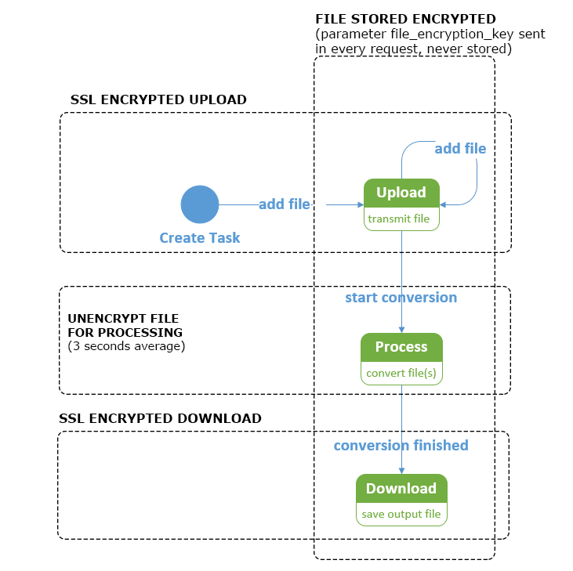
File encryption server side

Slide 26
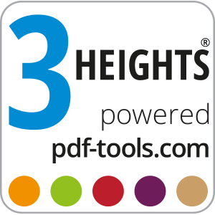
Third challenge: variety of modification types
Main challenges:
Offer high quality and standard PDF processing
Different types of processing needs different platforms
Many PDFs are damaged or corrupted
How we overcame these challenges:
Implementing and developing PDF Tools AG technology
Standardizing the process:
Start
Upload
Processing
Download

Slide 27
iLovePDF API tools

Slide 28
Fourth challenge: make software development easy
Main challenges:
Make development easy
Teaching developers how to take advantage of PDF processing
Monitoring and optimizing processing
How we overcame them:
Offering official libraries in multiple languages:
PHP, JavaScript, Ruby, .NET
From one button in iLovePDF to 6 lines of code in the
iLovePDF API

Slide 29
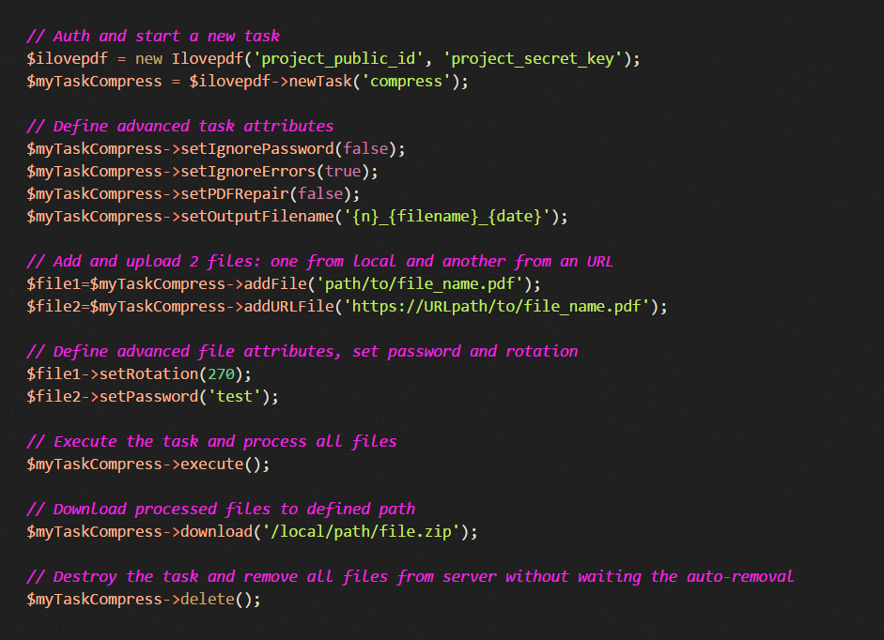
An advanced Library example

Slide 30
Fourth challenge: make software development easy
Good documentation
Complete API Reference
Libraries guides
Debugging options
Monitoring tools
Console panel monitoring
Google Analytics integration
Email support

Slide 31
Conclusions
We designed this API to solve the PDF problems of
corporate processors like ourselves
We thought of ourselves as the first client; the perfect solution for us would be one where the API team handled all the infrastructure, security, and required improvements. So that’s what we made.
And we’re adding technologies to make it even more useful!

Slide 32
PDF Days Europe 2017
Thank you! Any questions?
Marco Grossi
iLovePDF
marco.grossi@ilovepdf.com
developer.ilovepdf.com
Christoph Burkhalter
PDF Tools AG
pdfsupport@pdf-tools.com
www.pdf-tools.com

