Slide 1
PDF Days Europe 2017
Next Generation PDF and the PDF Association
Leonard Rosenthol PDF Architect & Senior Principal Scientist Adobe Systems
Matt Kuznicki Chief Technical Officer - Datalogics Chairman of the PDF Association
1

Slide 2

2016 State of the Union What frustrates users about PDF?

Slide 3
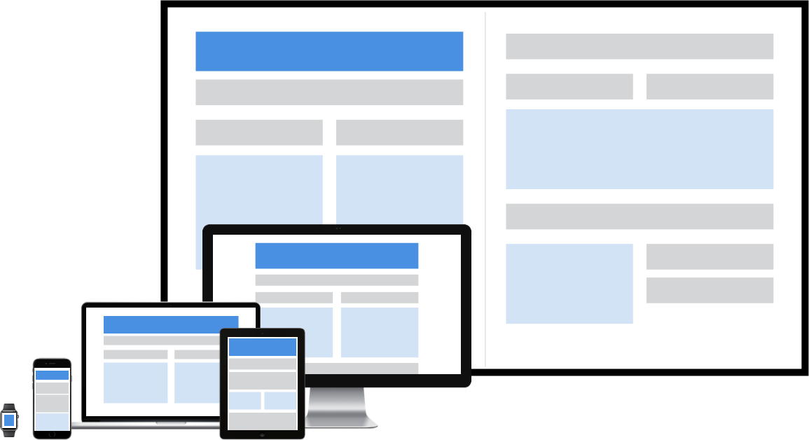
PDF Not Engineered for the Modern Device Era

Slide 4
Some details
Modern Devices & Apps are changing customer expectations (Interactive, Touch, Responsive)
Viewing PDF on mobile isn’t ideal: pinch & zoom
Growing number of citizens (particularly low-income families & individuals) are “mobile-only”
Authoring accessible PDFs is too expensive: $100K - $250K today
Required by law to provide Accessible solutions
PDF isn’t a great experience for screen readers & vision-impaired reading
Frustrated with inability to get data out of PDF

Slide 5
Continuing to deliver on our promise our customers
Users know PDF.
Users know that they can easily send & receive PDFs.
Users have PDF viewers.
PDF provides a strong foundation.
No other format addresses the new requirements.
The PDF ecosystem is huge.

Slide 6
Proposal
PDF Association should start a Technical Working Group
Consider proposals from members
at least four companies presented about this at Technical Conference
Work towards a common specification

Slide 7
….2017

Slide 8
Next Generation PDF and the PDF Association
We’ve been developing the next generation of PDF

Slide 9
Next Generation PDF and the PDF Association
The PDF Association has been:
Hosting the standards development process
Crafting market research and messaging
Leading the development of implementation best practices and practical considerations
Managing the mechanics of standards and document editing and publication
We are committed to openness to our members in all of these activities

Slide 10
Managing the Standards Development Process
The Technical Working Group (TWG) is where the Next Generation PDF work is taking place:
Launched by the PDF Association in the summer of 2016 - ~40 member companies currently
Facilitating open and active debate and advancement of technical concepts and standards
Publishing frequent draft specifications for discussion and collaboration
Open development process: any PDF Association member can participate

Slide 11
Crafting Market Research and Messaging
The Marketing Working Group (MWG) is where the Next Generation PDF marketing activities are coordinated:
Launched by the PDF Association in the summer of 2016 - ~25 member companies currently
Conducting research and messaging development
Collecting industry verticals, use cases and benefits
Promoting awareness with PDF Association members
Open process: any PDF Association member can join and participate

Slide 12
Next Generation PDF: Standards Development
So what did we develop?

Slide 13
Important Concepts for Next-Generation PDF
The Next Generation of PDF will:
Be PDF 2.0 (with full functionality)
Be “well tagged” PDF
Maintain reliable document rendering and interchange
Enable presentation adaptation to the circumstances and device used to render the PDF
Extend PDF into a variety of new and different workflows and use cases
With broad and open industry participation
Notes:
Author driven presentation adaptation:
Reflow and content resize ability for different screen types and sizes
Better read-aloud and text-to-speech for accessibility
Default presentation adaptation to rendering device type
Selection of different default presentations based on location, on who you are, etc.
Extend PDF into new workflows and use cases:
Dynamically updatable charts and dashboards
Network aware document presentation
True extractability of semantic content and styling without heuristic-driven processes
Optimized presentations for different audiences
Maintain reliable document rendering and interchange:
Remaining as a document that can be given to others and used effectively
Continuing to carry a perfect rendition of author’s intended appearance through space and time
Keep the uniquely good features of PDF for the next generation:
Born as a format for expressing the design intent of content creators
Digital documents that can drive business workflows
Digital signatures that can be used to verify document integrity
Commenting and revisioning that allow for collaboration
Form capabilities that allow for data collection and consolidation
Archive capability in single file format that can be used across a spectrum of use cases
Be PDF 2.0 right from the start:
Not being tethered to deprecated practices and concepts
Broad and open industry participation
Collaboration in open forums
Equal participation in standards and best practices development, marketing, etc.

Slide 14
Next Generation PDF: Standards Development
Diving Deeper at PDF Days

Slide 15
Next Generation PDF Track: PDF Days 2017
Core concepts and use cases
Relationship to other technologies
Overcoming challenges in content presentation adaptation
Responsiveness to different viewing and usage scenarios
Server-side workflows
Document accessibility benefits
Content repurposing advancements
Best practices in document creation

Slide 16
Next Generation PDF Track: PDF Days 2017
Please join us:
Learn about the Next Generation of PDF
Help create the Next Generation of PDF
Help promote the Next Generation of PDF
Here’s to the next generation of PDF!

Slide 17
PDF Days Europe 2017
Thank you! Any questions?
Get in touch: matt.kuznicki@pdfa.org | leonardr@adobe.com Web site: www.pdfa.org Twitter: PDFassocation
17

